Slide 1
PLAN JP/ROX COMMUNITY WORKSHOP #5 DEVELOPMENT IDEAS & FUTURE VISIONS FOR JP/ROX

Slide 2
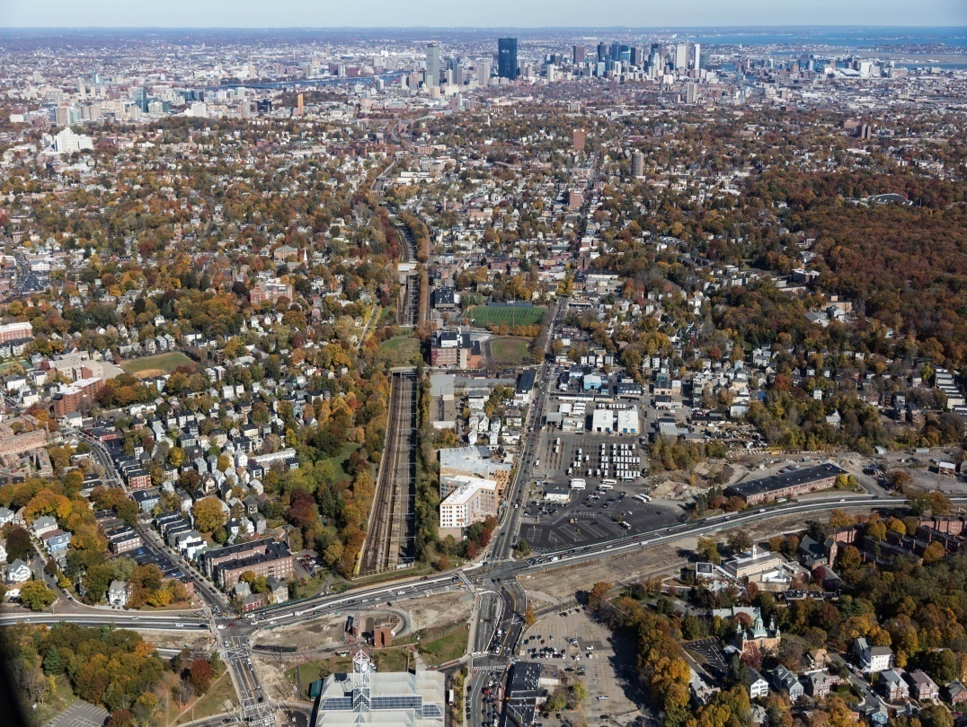
AGENDA
Welcome and Update
PLAN JP/ROX Overview
Report on CW4 –
Connecting People with Places
Information:
JP/ROX Housing Goals
Value Capture & Feasibility
Development Scenarios
Station Overview
Six Stations
Wrap Up and Adjourn

Slide 3
1
PLAN OVERVIEW
Future Planners from the Neighborhood School
Notes:
This is where you talk about Planning for People 40 top questions,mostly about affordable housing strategies, including IDP. Give IDP update. Direct people to the board at open house.

Slide 4
PROCESS TO DATE
CW # 1: Visioning Session
CW # 2: Community Resiliency & Sustainability
CW # 3: Land Use & Development
CW # 4: Mobility & Connectivity Public Realm & Placemaking
CW # 5: Future Visions of JP/ROX
September 30, 2015
January 21, 2016
November 4, 2015
March 5, 2016
December 10, 2015

Slide 5
PLAN JP/ROX THEMES
Community Resiliency & Sustainability
Land Use & Development
Mobility & Connectivity Public Realm Placemaking

Slide 6
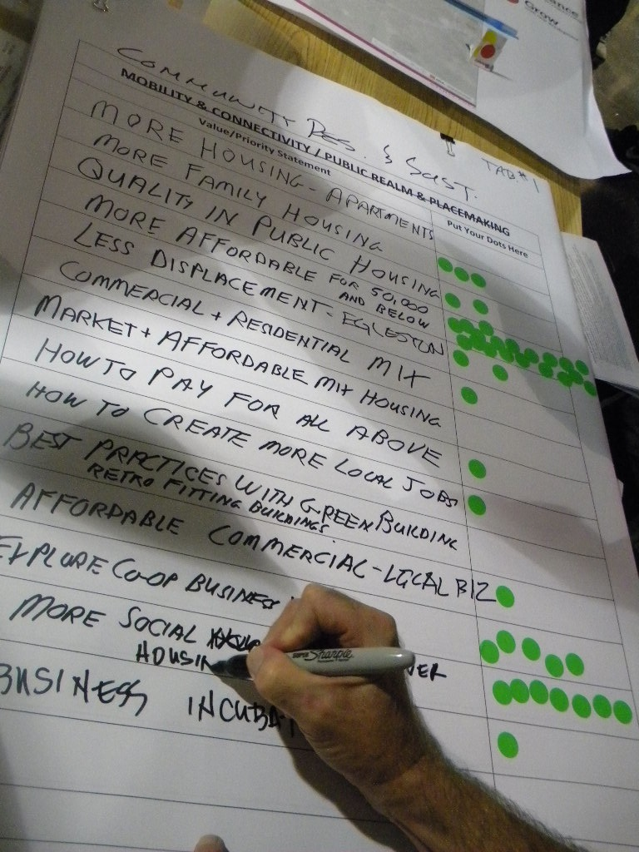
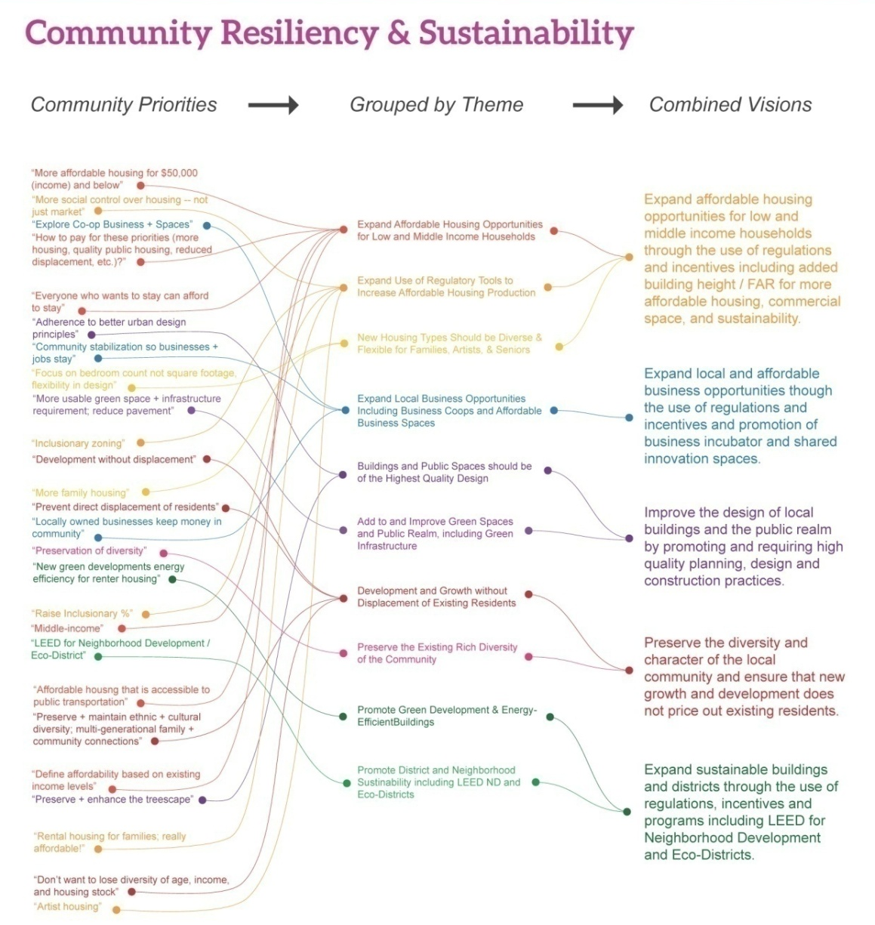
COMMUNITY WORKSHOP #1 VISIONING SESSION
SEPTEMBER 30, 2015

Slide 7
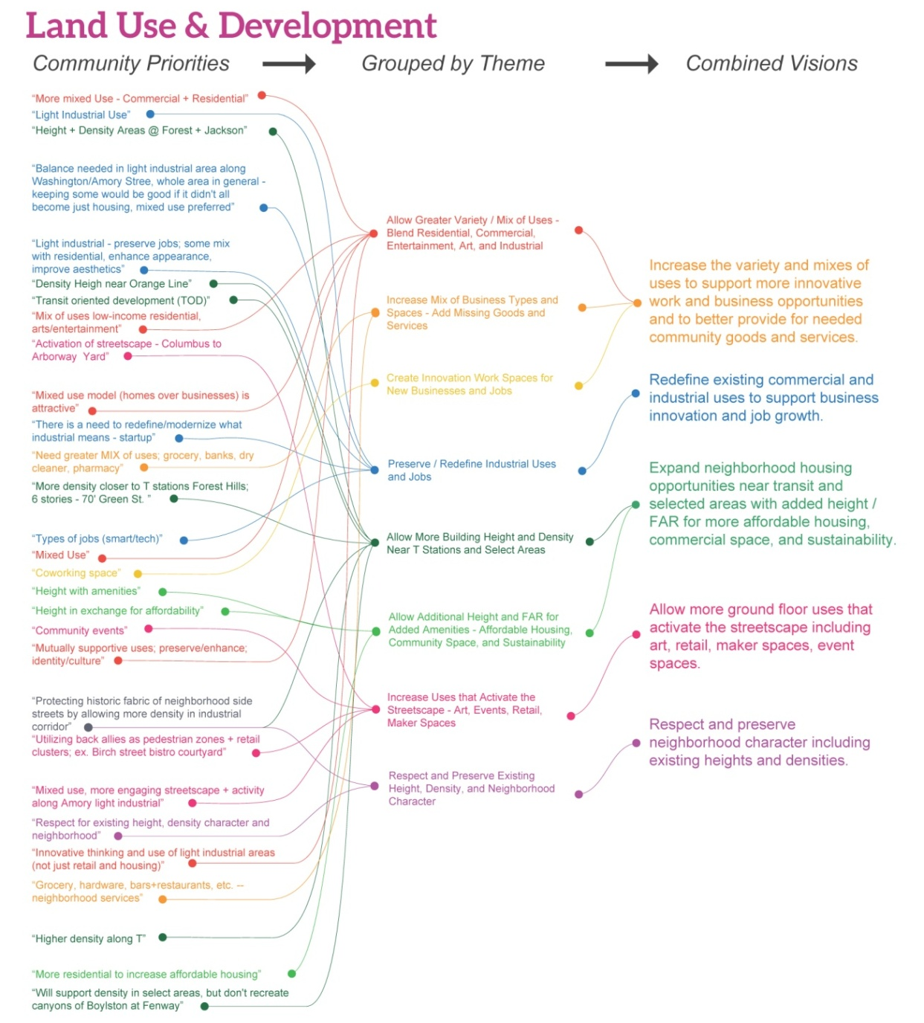

Slide 8
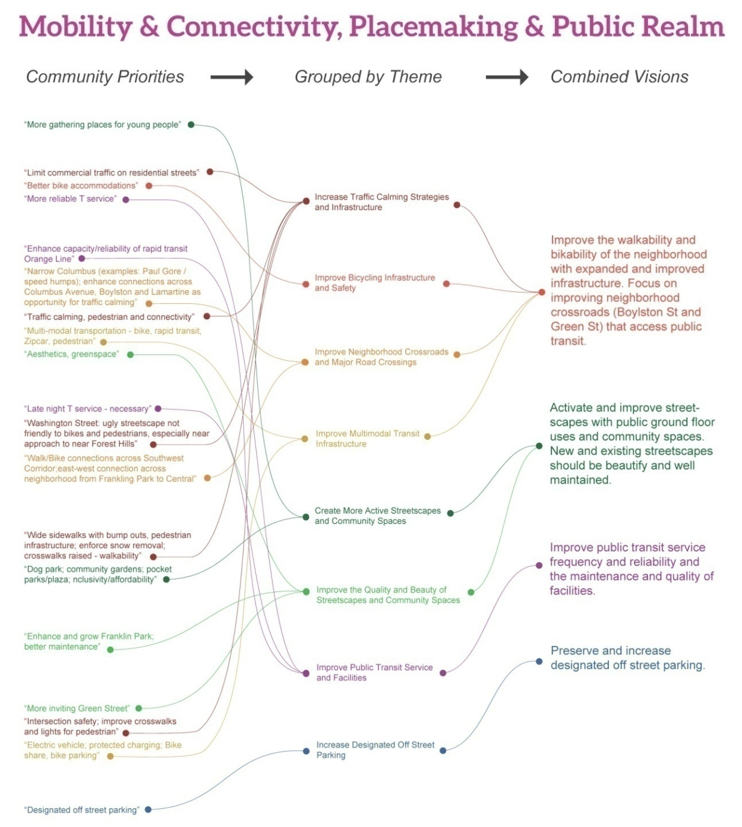

Slide 9
Community Visioning Process
PLAN JP/ROX envisions a friendly, fun, walkable, safe, attractive and green community
Promote new affordable housing and retail that supports the social and economic diversity of the area
Guide growth that strengthens the community and respects the physical character of the existing residential areas
Increase the variety of uses to create more innovative job and business opportunities, and strengthen existing local and small businesses
Promote energy efficient buildings, green development, and neighborhood sustainability
Support artistic, civic, cultural and community assets
Enhance connections in and around and out of the area
Improve the safety and reliability of the many options for getting around the area
8. Create active and vibrant streets, sidewalks and public places

Slide 10
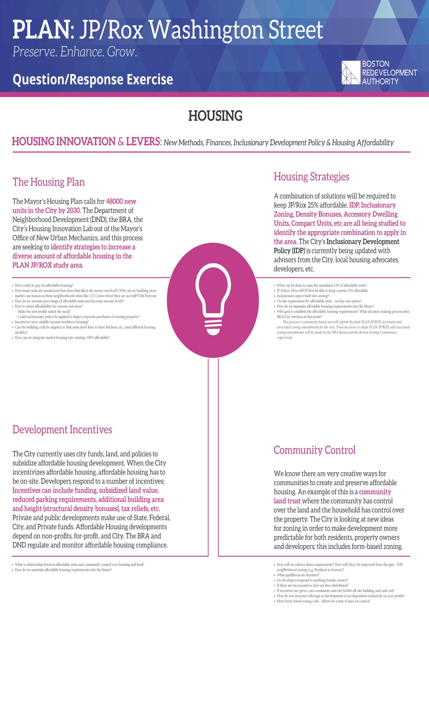
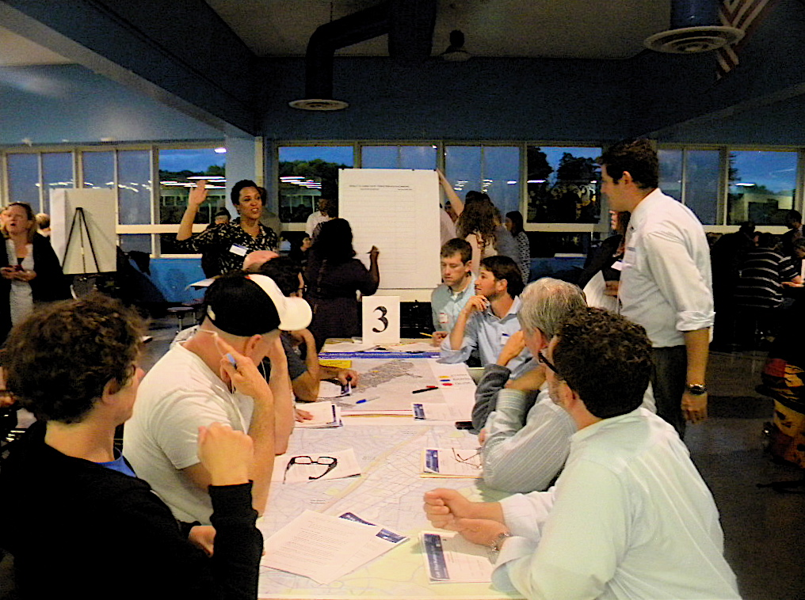
COMMUNITY WORKSHOP #2
Theme 1: Community Resiliency & Sustainability
NOVEMBER 4, 2015

Slide 11
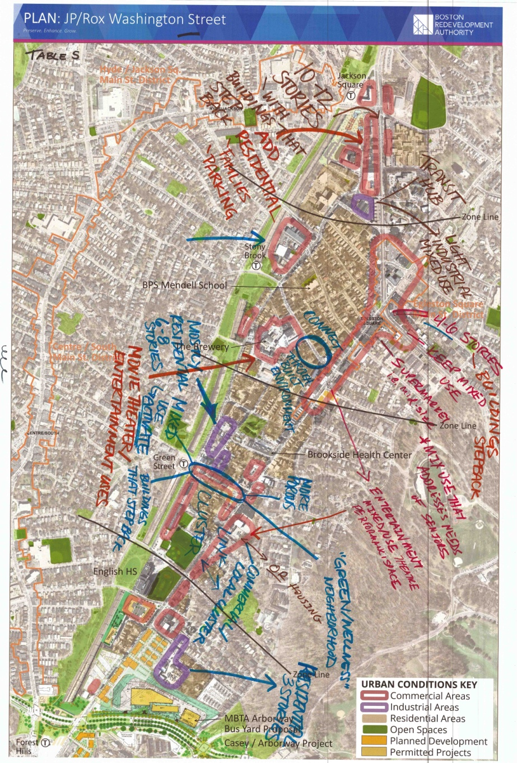
COMMUNITY WORKSHOP #3
Theme 2: Land Use & Development
DECEMBER 10, 2015

Slide 12
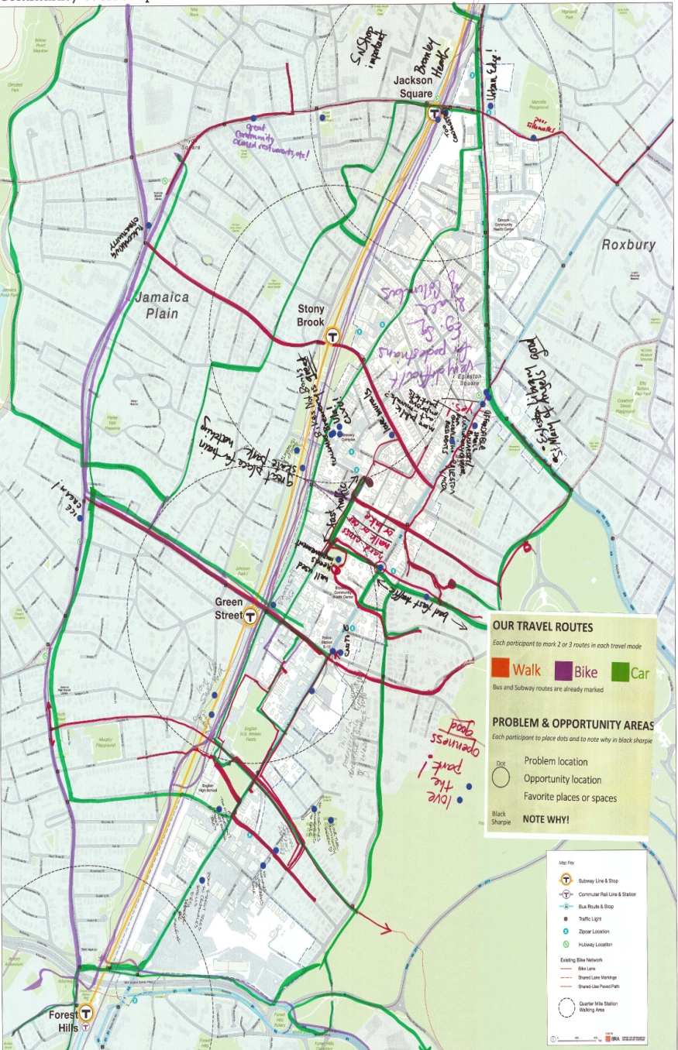
COMMUNITY WORKSHOP #4
Mobility & Connectivity Public Realm & Placemaking
JANUARY 21, 2016

Slide 13
PLAN JP/ROX THEMES
Community Resiliency & Sustainability
Land Use & Development
Mobility & Connectivity Public Realm Placemaking

Slide 14
PLAN CALENDAR
MARCH 5, 2016 “Future Visions for JP/ROX”
Draft Plan Scenarios and Recommendations
APRIL 2016 “Discuss with Us”
Draft PLAN Recommendations / Implementation Ideas
MAY 2016 “Finalize with Us”
DRAFT Final Plan Presentation
JUNE
PLAN Approval → BRA Board
EARLY-MID SUMMER
Public Workshops –Draft Zoning Amendments
END SUMMER 2016
Zoning Amendments → Boston Zoning Commission
JULY 28, 2015 “Talk With Us”
Open House
SEPTEMBER 1, 2015 “Walk With Us (Bike Too)”
Study Area Tours
SEPTEMBER 30, 2015 “Imagine with Us”
Visioning Workshop
NOVEMBER 4, 2015 “Planning For People”
Community Resiliency and Sustainability
DECEMBER 10, 2015 “Planning For Places”
Land Use and Development
JANUARY 21, 2016 “Connecting People & Places”
Mobility & Connectivity and Public Realm & Placemaking

Slide 15
WORKSHOP GOALS
Hear about the City’s continued commitment to incorporate more affordable housing into study area
Understand the many tools to do this
Revisit how we capture value through development and create benefits - and the associated limits
Provide feedback on how we can achieve the corridor-wide affordable housing goal
Provide feedback on conceptual development scenarios that have been crafted with past participant feedback

Slide 16
2
INFORMATION
JP/ROX Housing Goals
Notes:
This is where you talk about Planning for People 40 top questions,mostly about affordable housing strategies, including IDP. Give IDP update. Direct people to the board at open house.

Slide 17
JP/ROX HOUSING GOALS Devin Quirk Director of Operations Department of Neighborhood Development (DND)

Slide 18
JP/ROX Housing Goal:
Ensure growth prioritizes affordable housing creation while protecting existing low & moderate income households from displacement
How Can We Get There?
We have three tools to achieve this goal:
Zoning tools to create affordability at private development sites
Subsidy tools to create affordability at public/non-profit development sites
Policy tools to assist renters in existing market rate rental housing

Slide 19
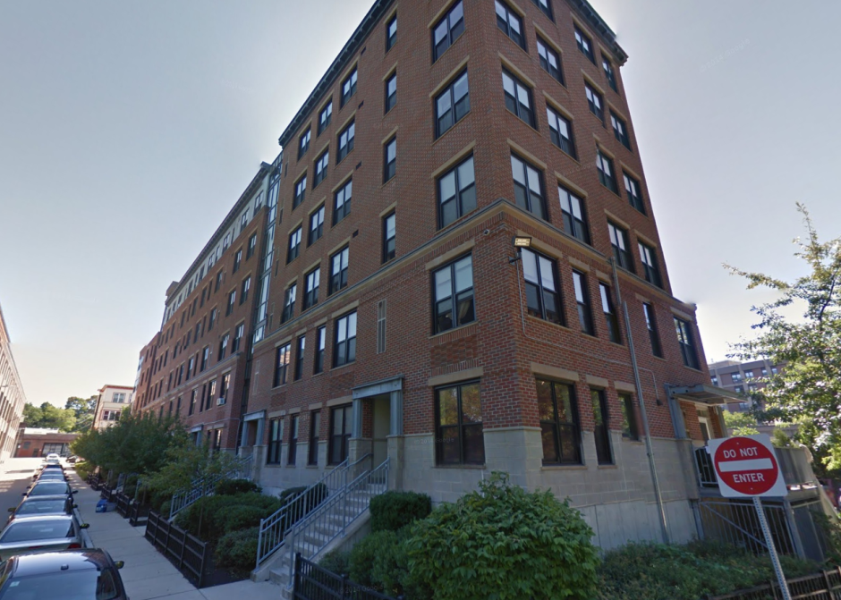
Zoning Tools To create affordable housing in private developments
Inclusionary Development Policy (IDP)
Redesigned in December 2015
Requires 13% of new units built be affordable (more if delivered off site)
Currently only applies to projects >10 units seeking zoning variances
Inclusionary Zoning
Requires all projects, including “as of right” projects to participate in IDP
We are committed to launching the City’s first inclusionary zoning as part of the JP/Rox plan
Density Bonuses
Allow buildings of greater density only if they provide greater affordable housing commitments
Amory Residences: Urban Edge

Slide 20
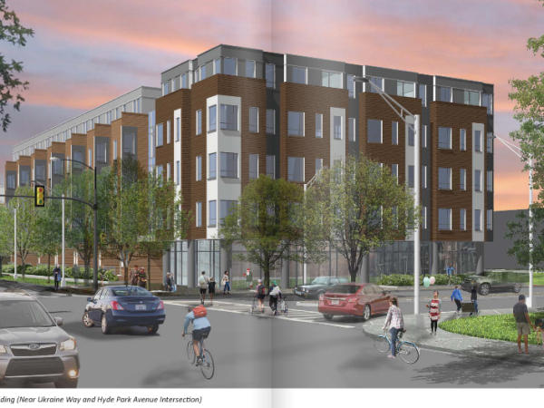
Subsidy tools To fund affordable housing in community developments
Tax Credits issued by the State
Projects across Commonwealth compete for access
Affordable Housing Development Funds
Community Development Block Grants, Neighborhood Housing Trust, IDP cash out funds, etc.
Publically Owned Land
Requirements to create higher levels of affordable housing as part of any land sale transaction
Parcel U @ Ukraine & Hyde Park Ave in Forest Hills
MBTA land disposition

Slide 21
Policy Tools Renters at risk in existing market rate housing
Mayor Walsh’s Office of Housing Stability (OHS)
Announced in January 2016 at State of the City
Located at the Dept. of Neighborhood Development starting later this Spring
Assistance with: Case Management, Housing Search, Legal Referrals, Policy Coordination
Acquisition and conversion of rental housing stock to affordable housing
$7 million available to CDC’s now to assist
Incentives to encourage landlords to keep rents affordable

Slide 22
Housing Need in JP/Rox

Slide 23
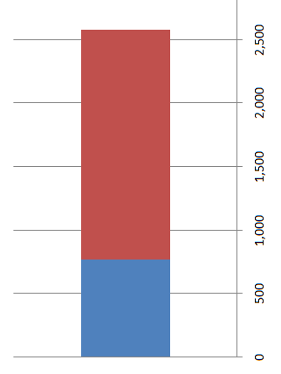
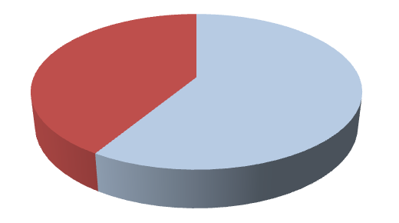
Existing Housing in JP/ROX
There are 2,579 housing units in the study area
29% are deed restricted affordable housing (748 units)
Renter/Homeowner breakdown
30% are owner occupied units (766)
70% are rental units (1,813)
All 748 affordable housing units are rentals
Therefore, there are 1,065 market rate rental apartments
Rent
Own
Rental Units
Affordable
Market
FINDING: Low/moderate income households living in market rate rentals are most
at risk for displacement

Slide 24
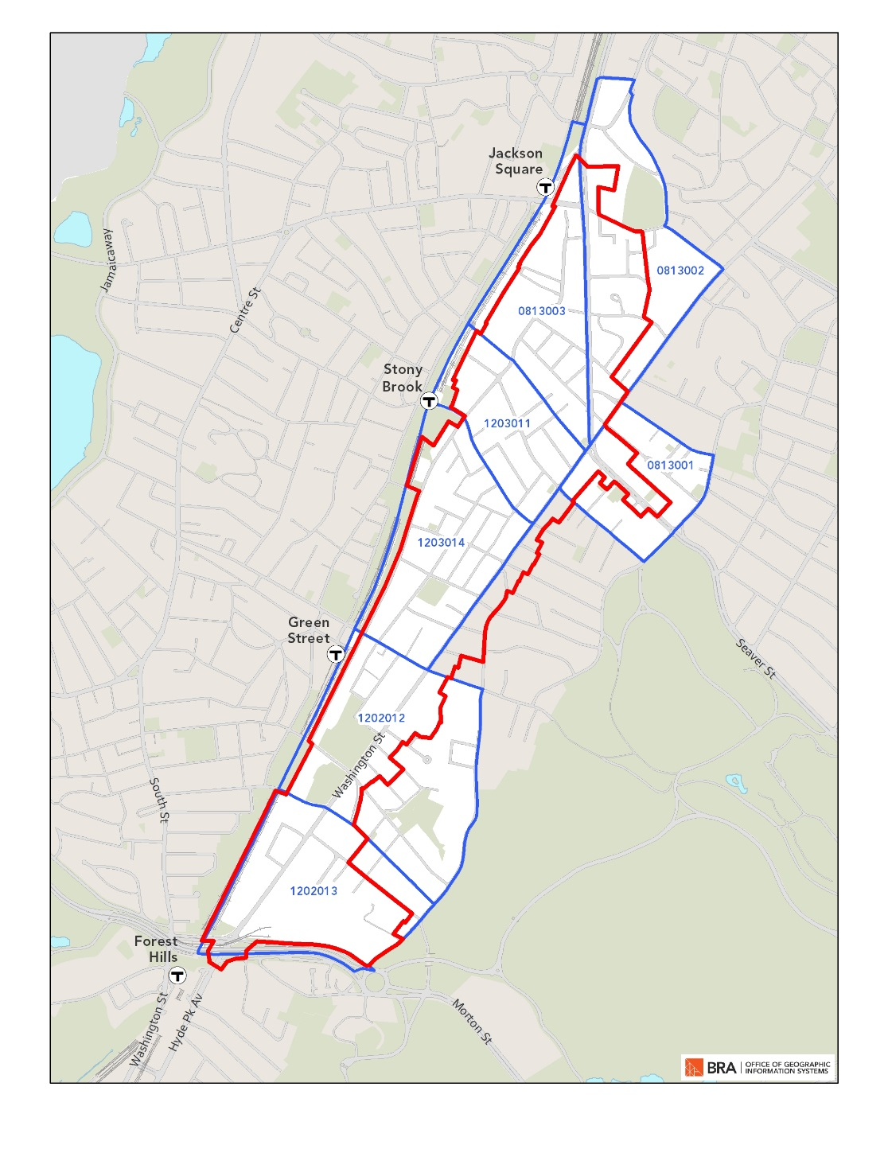
Estimating Need:
Census Block Groups that Generally Correspond with the Study Area

Slide 25
Issue: Market renters at risk for displacement Best Solution: Get them into deed-restricted units
70 Percent of Renter Households in Block Groups Have Income Less than $50,000
Renter Households in Study Area: 1,813
Estimate of Renter Households with
Income Less than $50,000 (70% of total) 1,269
Deed Restricted Affordable Housing -748
Renter Households Most at Risk: 521
Finding: There are an estimated 521 renter households most at risk for displacement in the Study Area

Slide 26
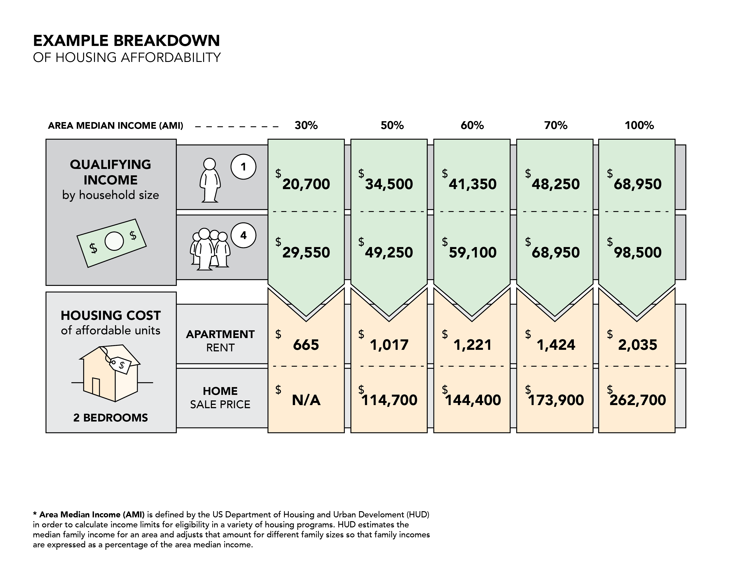
What do we mean by “Affordable Housing”

Slide 27
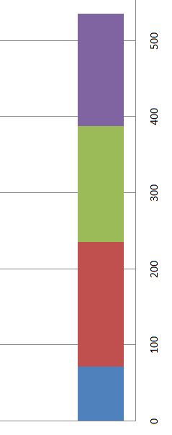
The City and JP/ROX have a proud history of creating affordable housing
Between 2000 and 2015, approximately 903 housing units built in Ward 11, of which 536 (or 59%) are deed restricted affordable
148 are for middle income households
Mostly up to 70% AMI
153 are for households below 60% AMI
Approximately $41k-59k annually
164 are for households below 50% AMI
Approximately $34k- 49k annually
71 are for households below 30% AMI
Approximately $20-29k annually
Up to 70% AMI
<60% AMI
<50% AMI
<30% AMI

Slide 28
Draft Housing Goals
for Community Feedback

Slide 29
Proposed Goal: 30% of all newly created housing in JP/ROX is deed restricted affordable
WHY 30%?
Today 29% of housing is affordable
Meets needs of existing households facing displacement by providing additional affordable units (521 most at risk)
Goes above and beyond the IDP Requirement (13%)
Captures as much value for the community as possible, while still ensuring that housing quickly gets built
Incorporates your feedback:
PLAN JP/ROX Community Workshops
Community Advocacy
Imagine Boston 2030 - prioritized housing affordability

Slide 30
How will we achieve the 30% goal?
Community-wide (e.g., not on project basis)
Both private development and publically assisted projects
PRIVATE
Write IDP into zoning
13% of units are set aside as affordable for as-of-right projects
Target for moderate/middle income households at 70% AMI
Density bonuses for projects going above allowed density
This can ensure 17% to 21% of the total project is set aside as affordable
Need feedback on desired income levels
(Visit the Workshop Housing Station!!)
Publicly Assisted
Continue to work with CDC’s to prioritize projects in this area
Target low income households
(30% to 60% AMI)

Slide 31
Additional Affordability through this Process
Today, look at the range of development scenarios for additional housing density. We want your feedback!
EXAMPLE: A scenario yields 2,000 new housing units
The 30% goal would create 600 new units of affordable housing
Source of Units | Density Bonus at 50% AMI | Density Bonus at 100% AMI
Inclusionary Zoning | 219 | 225
Density Bonus | 68 | 104
Community Development Projects | 313 | 271
Total Units | 600 | 600

Slide 32
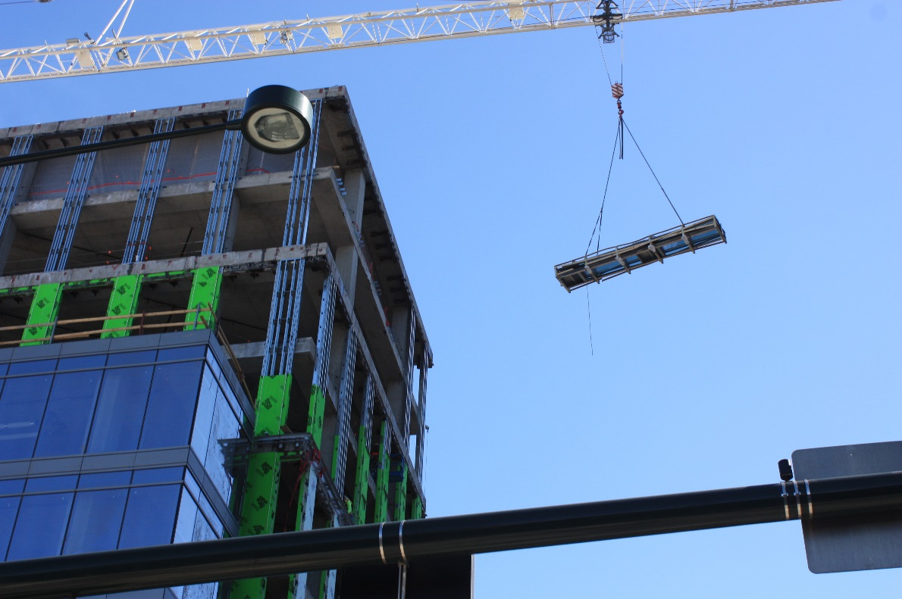
2
INFORMATION
Value Capture &
Feasibility

Slide 33
JP/ROX Public Benefits: Cost and Value
Value
Land Use
Development Density
Building Heights
Site Attributes
Market Conditions
Cost
Significant new (wider range) affordable housing
Local retail supports
New civic, cultural/art spaces
Affordable 21st century low impact manufacturing/start ups
Green Buildings/LEED gold or higher

Slide 34
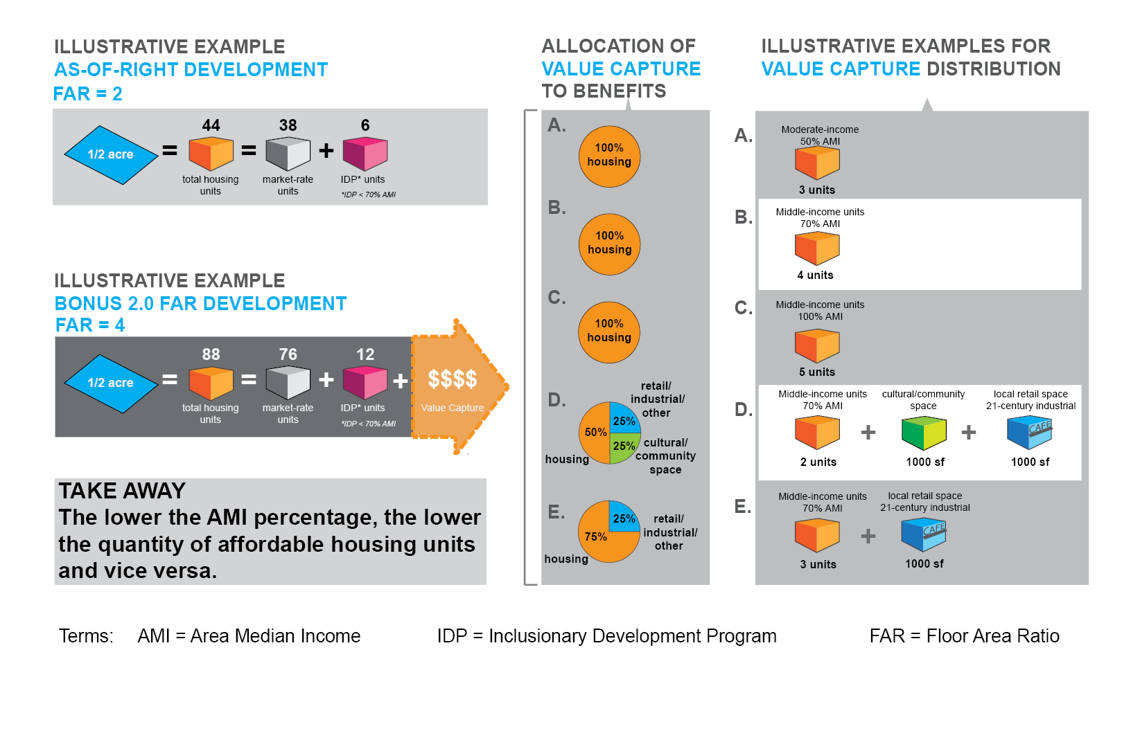
Density Bonus Concept: Increasing allowable development can create additional value that can be captured to support community benefits

Slide 35
Other Development/Market Concepts
Increasing allowable development creates more housing and more affordable housing (Inclusionary Development Zoning)
While there are missing businesses and services in the study area, requiring new retail space in the ground floor of every project is not the answer
To promote long term retail growth and stability in the study area, development of any significant new retail space should be targeted to fill specific needs and be located within existing active commercial zones

Slide 36
Development/Market Concepts (Cont’d)
Beyond 70 feet / 6 stories
Buildings must meet high-rise standards and are much more expensive to build
Added costs can be offset by added height
In JP Rox market, high-rise residential buildings would need to be over 14 stories tall to be financially feasible
Return on Cost
Stories

Slide 37
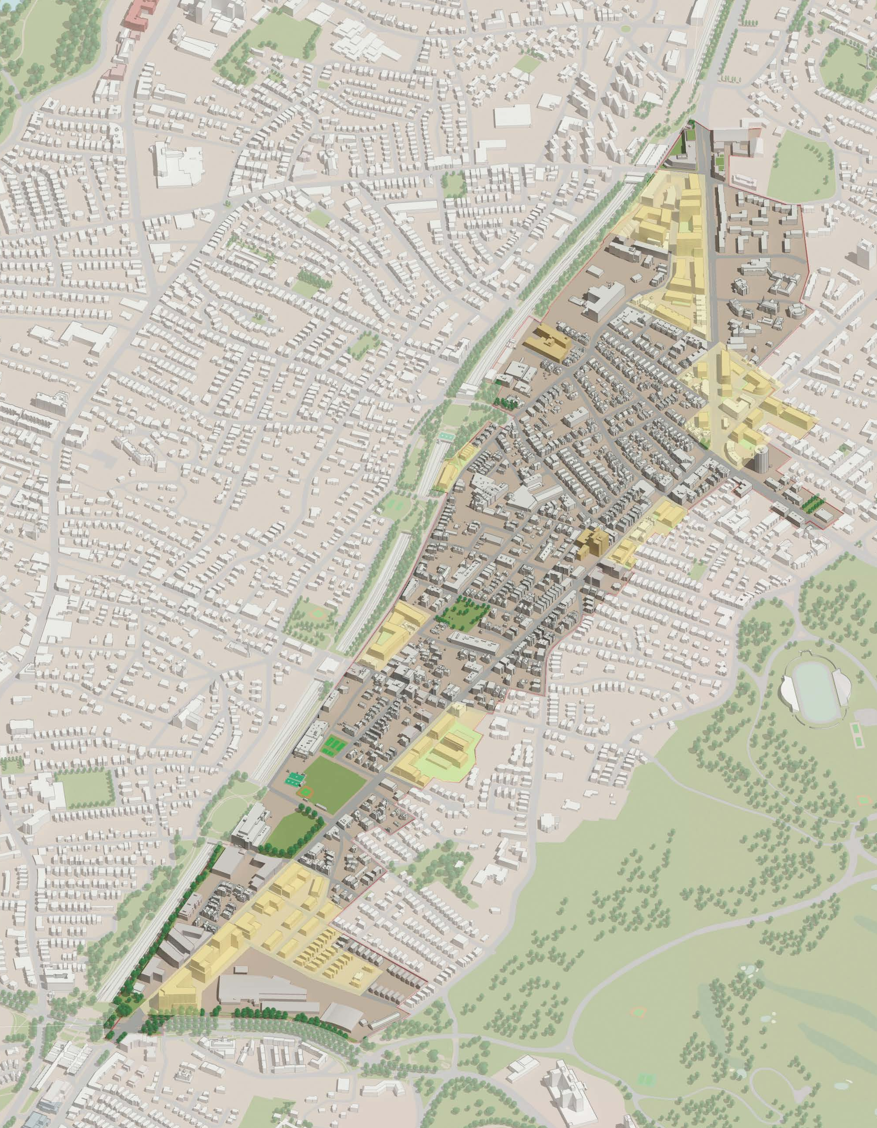
2
INFORMATION
Development Scenarios

Slide 38
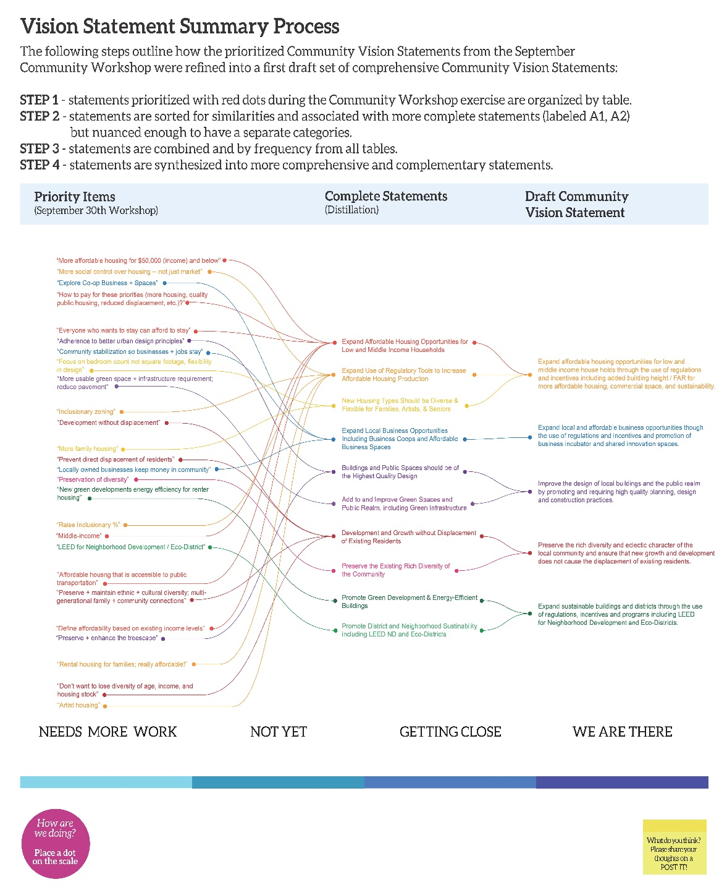
Community Vision
Promote new affordable housing and retail that supports the social and economic diversity of the area.
Guide growth that strengthens the community and respects the physical character of the existing residential areas.
Increase the variety of uses to create more innovative job and business opportunities, and strengthen existing local and small businesses.
(Partial listing):

Slide 39
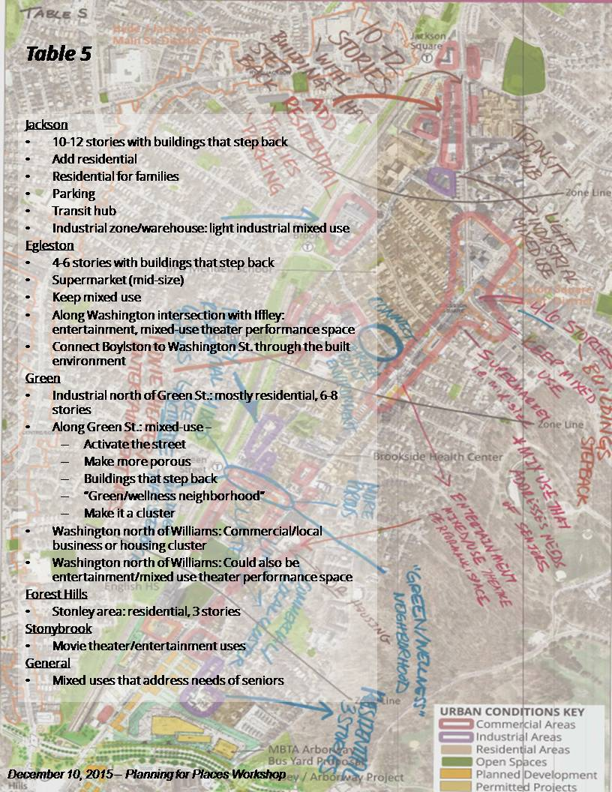
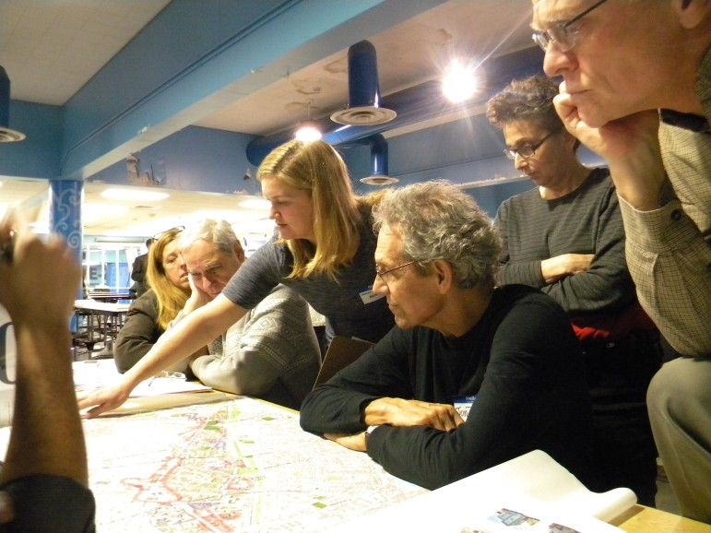
Land Use & Development
Recommendations
Community Workshop #3

Slide 40
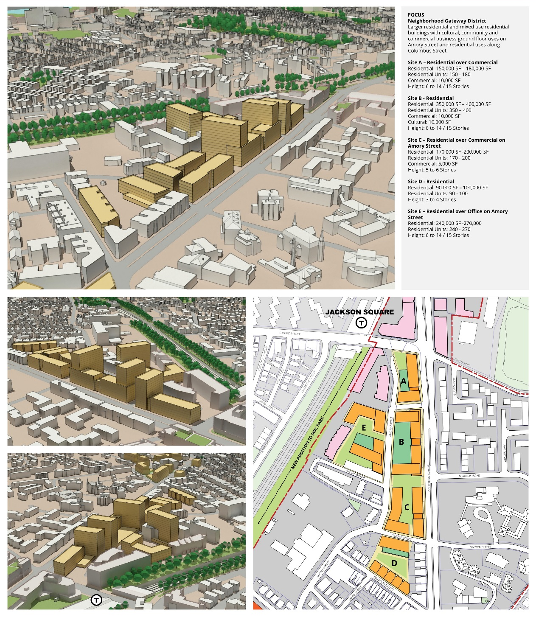
Jackson Square
Neighborhood Gateway District
Larger residential and mixed use residential buildings with cultural, community and commercial business ground floor uses on Amory Street and residential uses along Columbus Street.

Slide 41
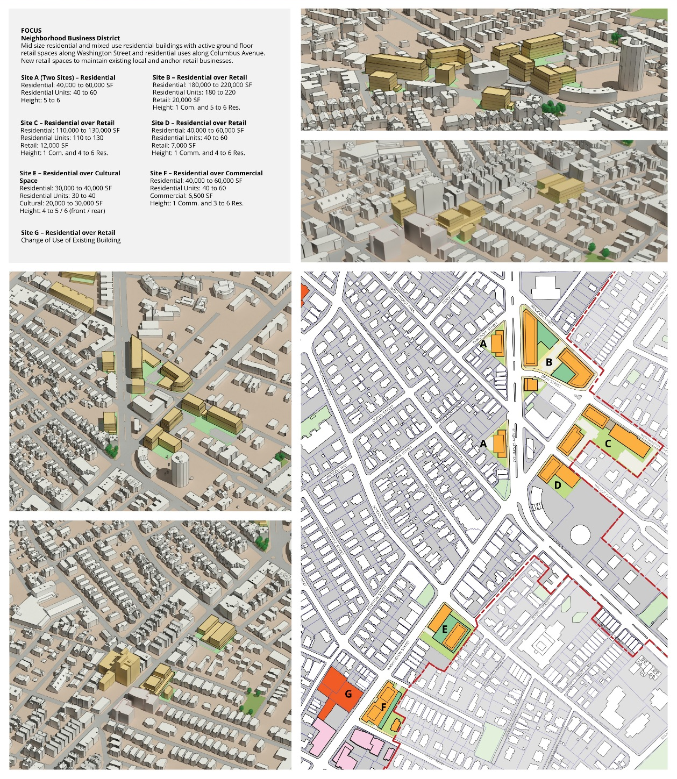
Egleston Square
Neighborhood Business District
Mid size residential and mixed use residential buildings with active ground floor retail along Washington St. and residential uses along Columbus Ave. New retail spaces to maintain existing local and anchor retail businesses.

Slide 42
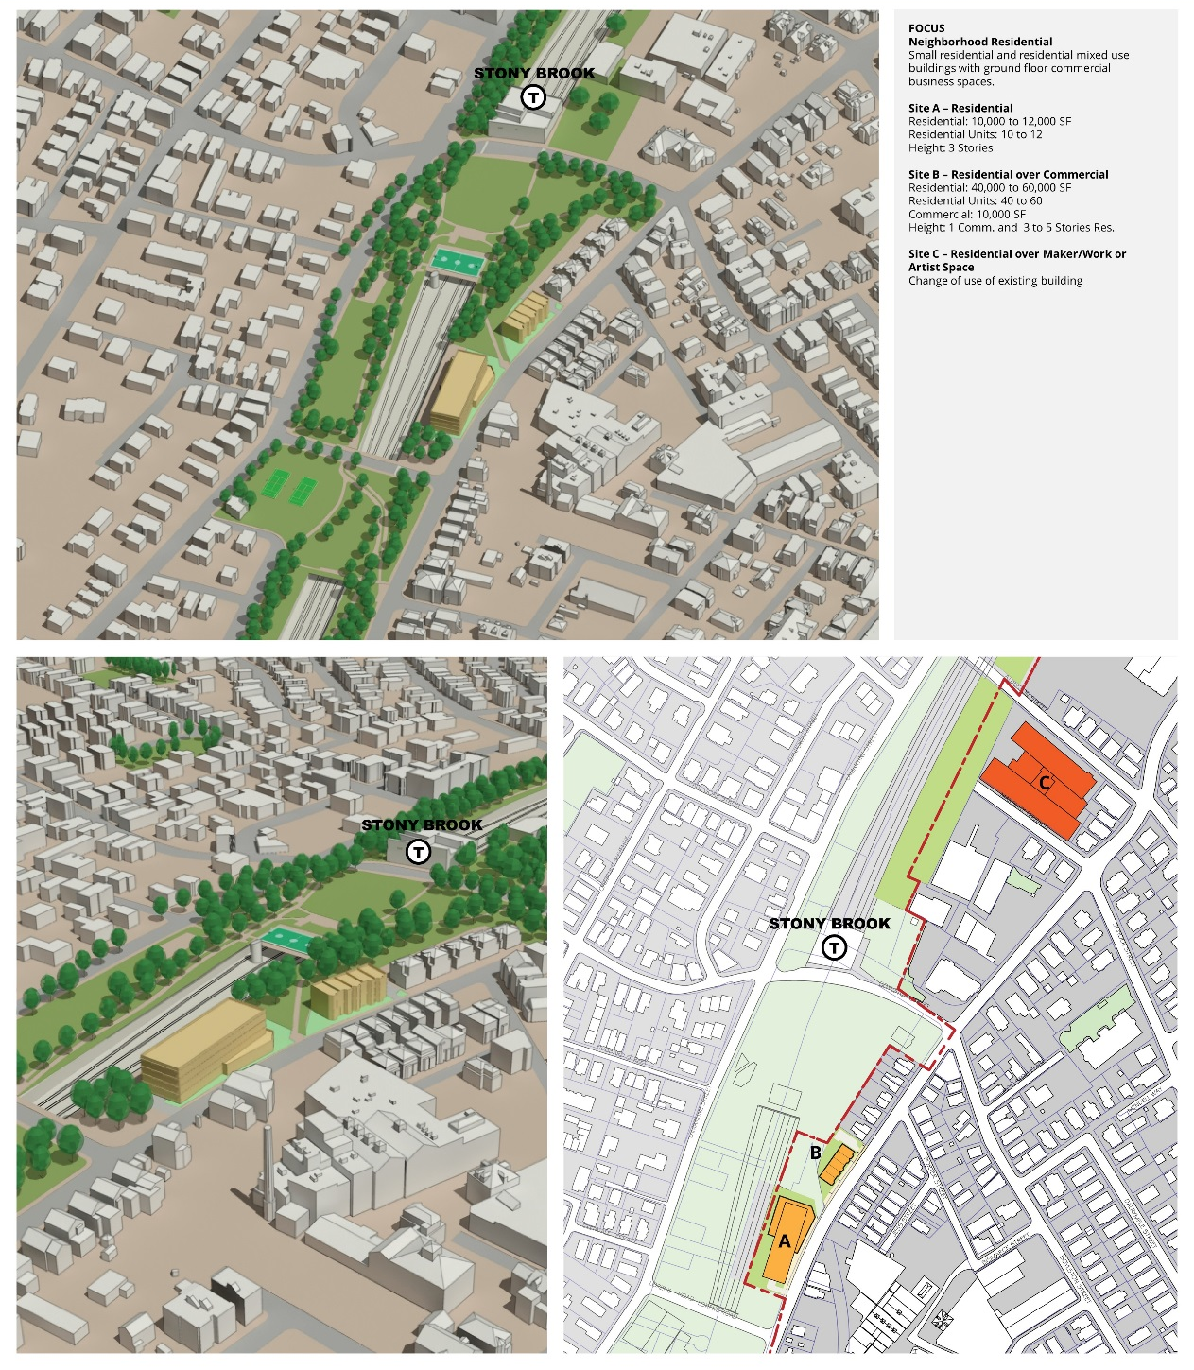
Stony Brook
Neighborhood Residential
Small residential and residential mixed use buildings with ground floor commercial business spaces.

Slide 43
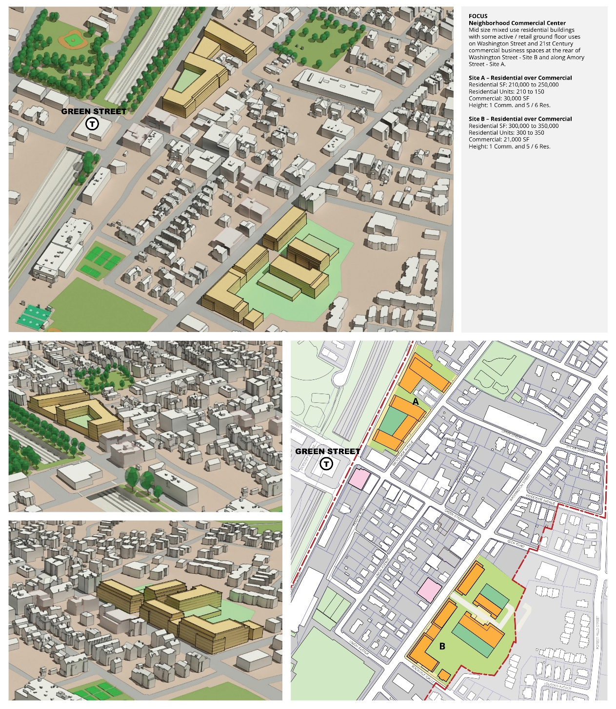
Green Street
Neighborhood Commercial Center
Mid size mixed use residential buildings with some active / retail ground floor uses on Washington Street and 21st Century commercial business spaces at the rear of Washington Street - Site B and along Amory Street - Site A.

Slide 44
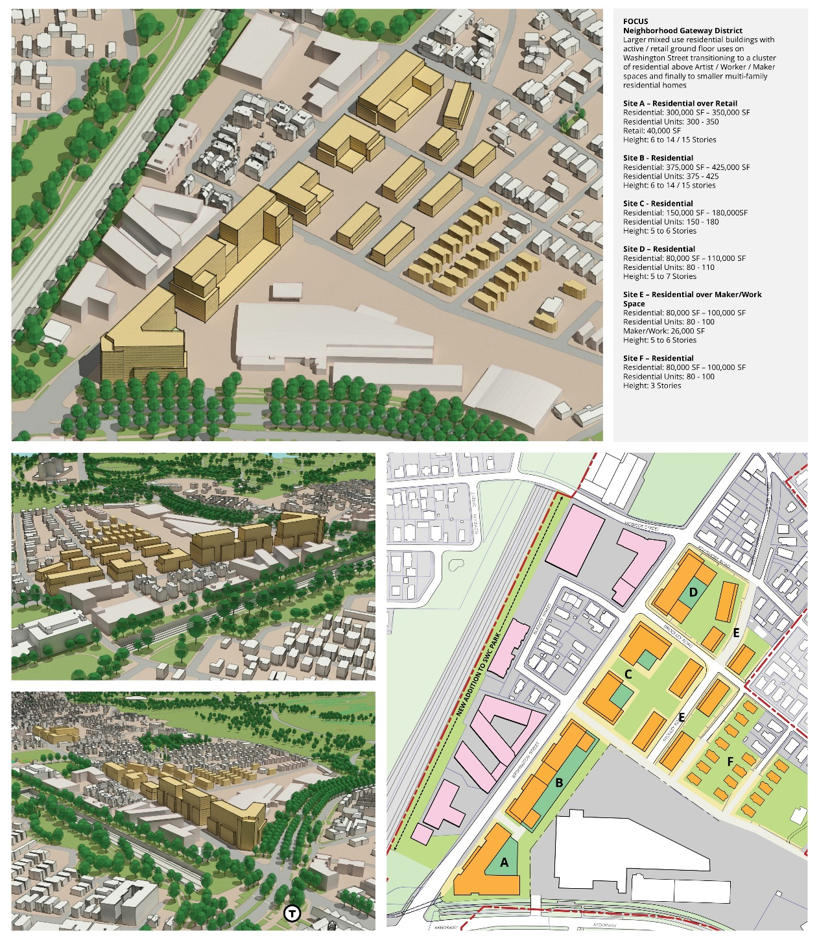
Forest Hills
Neighborhood Gateway District
Larger mixed use residential buildings with active / retail ground uses on Washington St transitioning to a cluster of residential above Artist / Worker / Maker spaces and finally to smaller multi-family residential homes

Slide 45
Exercise Overview Six Stations – Four 20 minute Sessions
Forest Hills
Green Street
Stony Brook
Egleston Square
Jackson Square
Housing Station
Feedback on 30% Community-wide Affordable Housing Goal
AMI Allocation Exercise for New Deed-Restricted Affordable Housing
Density Bonus Exercise

Slide 46
Development Scenario Feedback
VISION
Do the development scenarios contribute to fulfilling the community vision for the study area?
USES
Are the proposed primary uses right for this area? How about for each building or cluster?
Are the ground floor OR secondary uses right for this area? How about for each building or cluster?
What changes should be made to improve the mix of uses?
DESIGN
Are the proposed buildings positioned in the right location for this area? How about for each site?
SIZE
Are the size of the proposed buildings right for this area? How about for each site?
Do the proposed building shapes fit the area? How about for each site?

