Slide 1
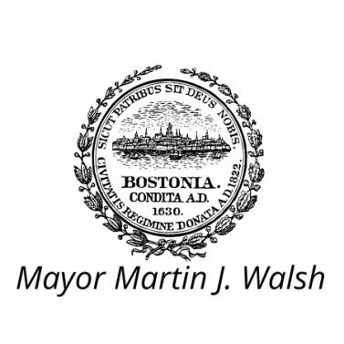
Transportation & public Realm Workshop
April 19, 2016

Slide 2
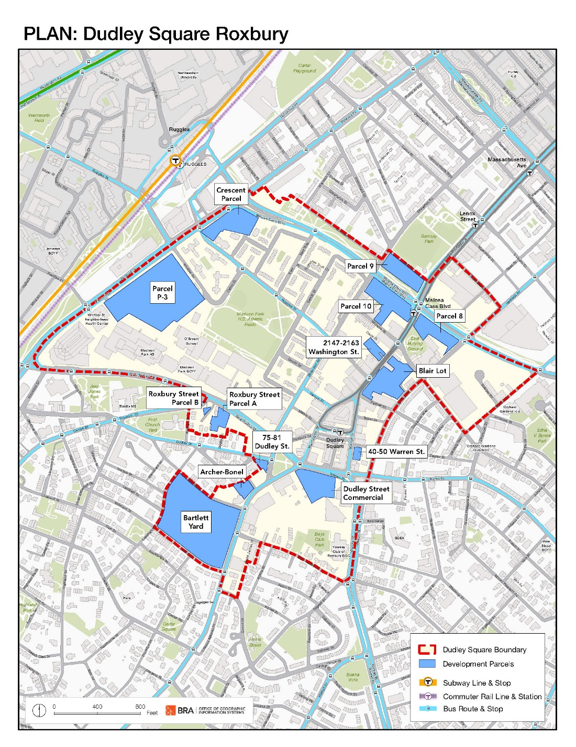
Agenda
WHY WE’RE HERE
1 PLAN: Dudley Square Overview
WHAT WE’VE HEARD
2 Open House
3 Walking Tour
4 Visioning Workshop
UPDATING THE VISION
5 Citywide Overview of Transportation Planning
6 Ongoing and Past Transportation Planning
TALK TO US
8 Transportation & Public Realm Exercise
Notes:
CN – Please go ahead and reword anything

Slide 3
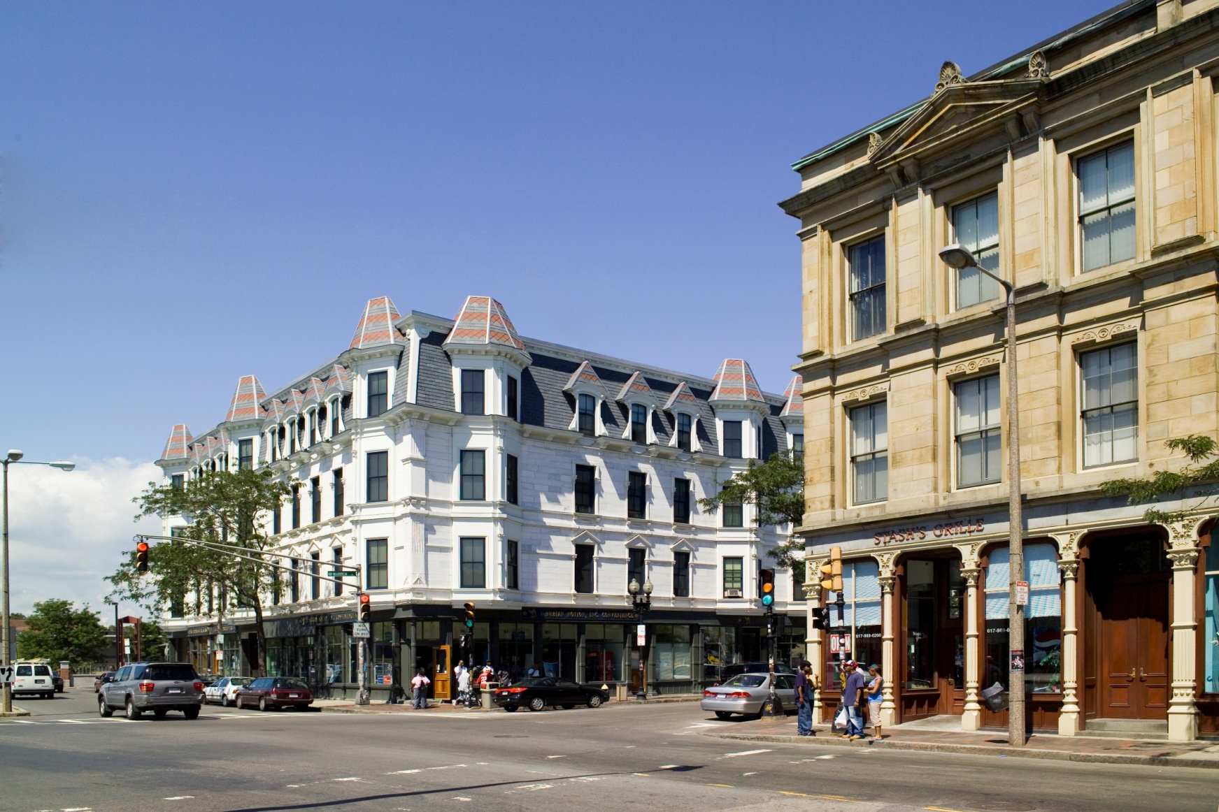
1
PLAN: Dudley Square Overview
Photo Credit: Peter Vanderwarker
Notes:
NEED

Slide 4
PLAN Calendar
FEBRUARY 22, 2016
Open House
MARCH 16, 2016
Walking Tour
MARCH 21, 2016
Visioning Workshop
APRIL 19, 2016
Transportation & Public Realm Workshop
MAY 16, 2016
Design & Feasibility Workshop
JUNE 20, 2016
Tools for Development Workshop
JULY 25, 2016
Preferred Plan Draft Session
AUGUST 1, 2016
Final Implementation Plan Presentation
AUGUST 11, 2016
BRA Board Approval
Notes:
KEEP BOARD DATE???

Slide 5
Study area

Slide 6
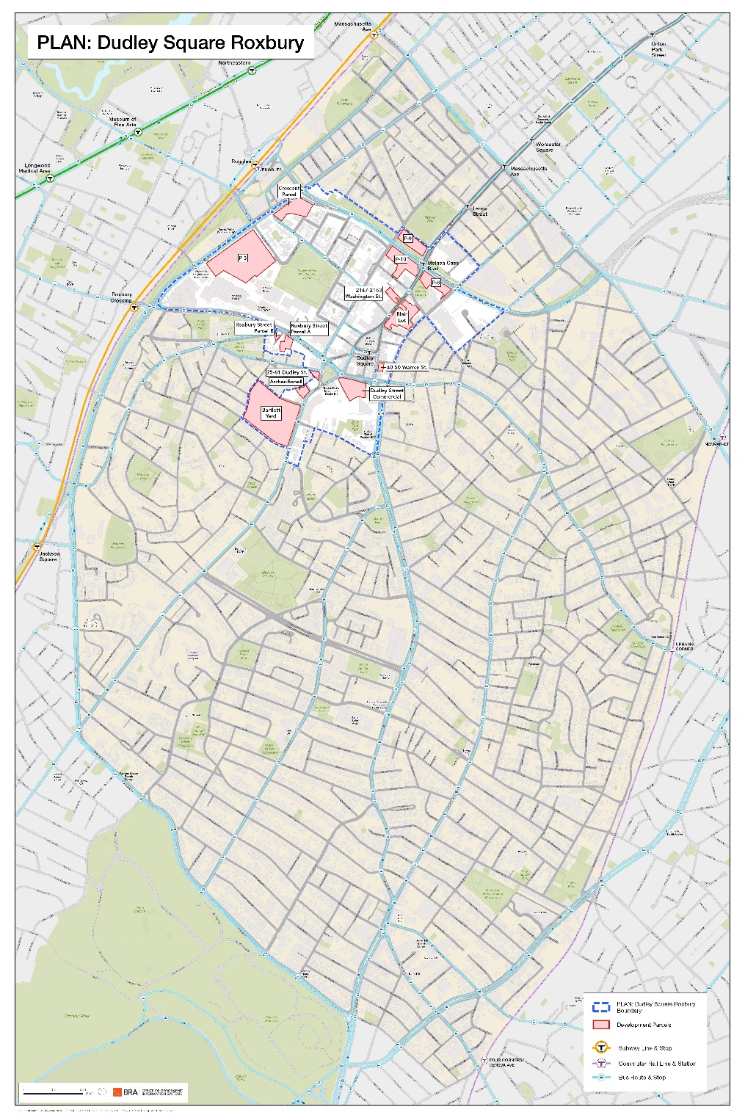
Study area context
Roxbury Map with Study Area

Slide 7
2
Open House
Open House
February 22, 2016

Slide 8
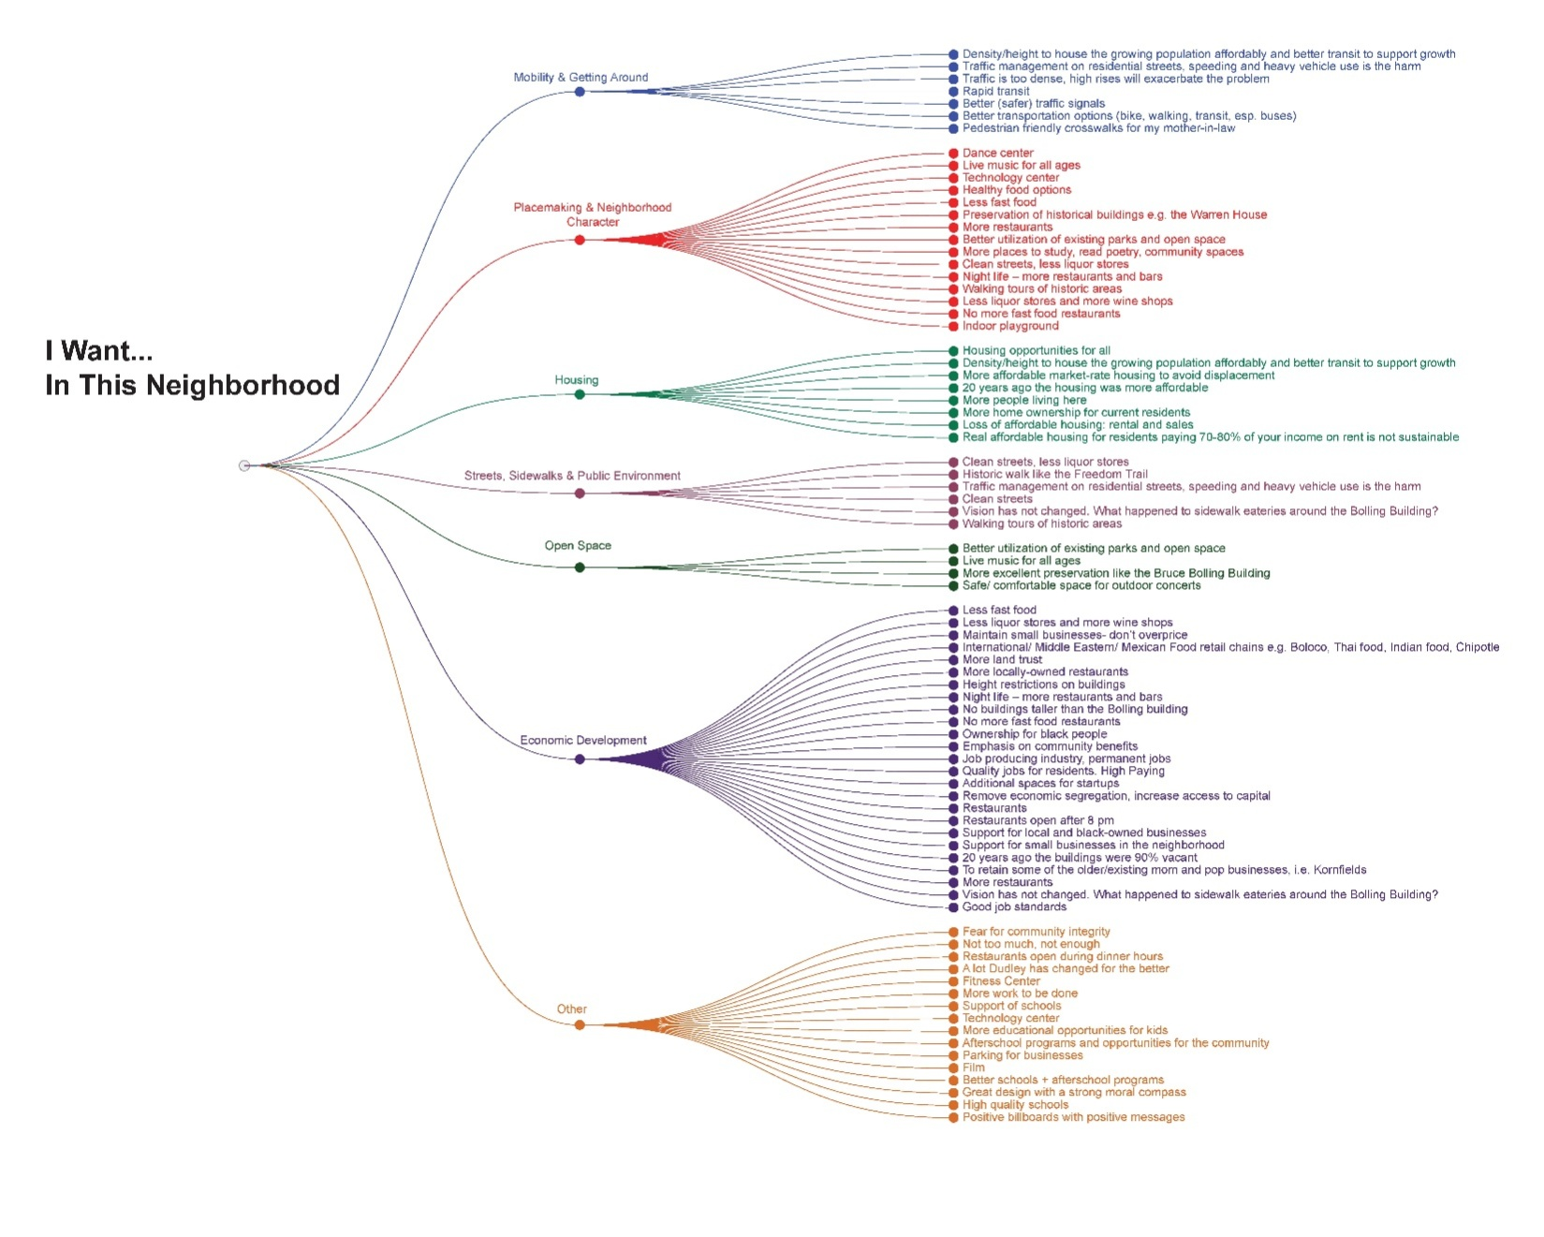
Open house comments
February 22, 2016
“Emphasis on community benefits”
“Housing opportunities for all”
“Better (safer) traffic signals”
“More recognition of history here”
“To retain some of the older/existing mom and pop businesses i.e. Kornfields”

Slide 9
3
Walking Tour
Walking Tour
March 16, 2016

Slide 10
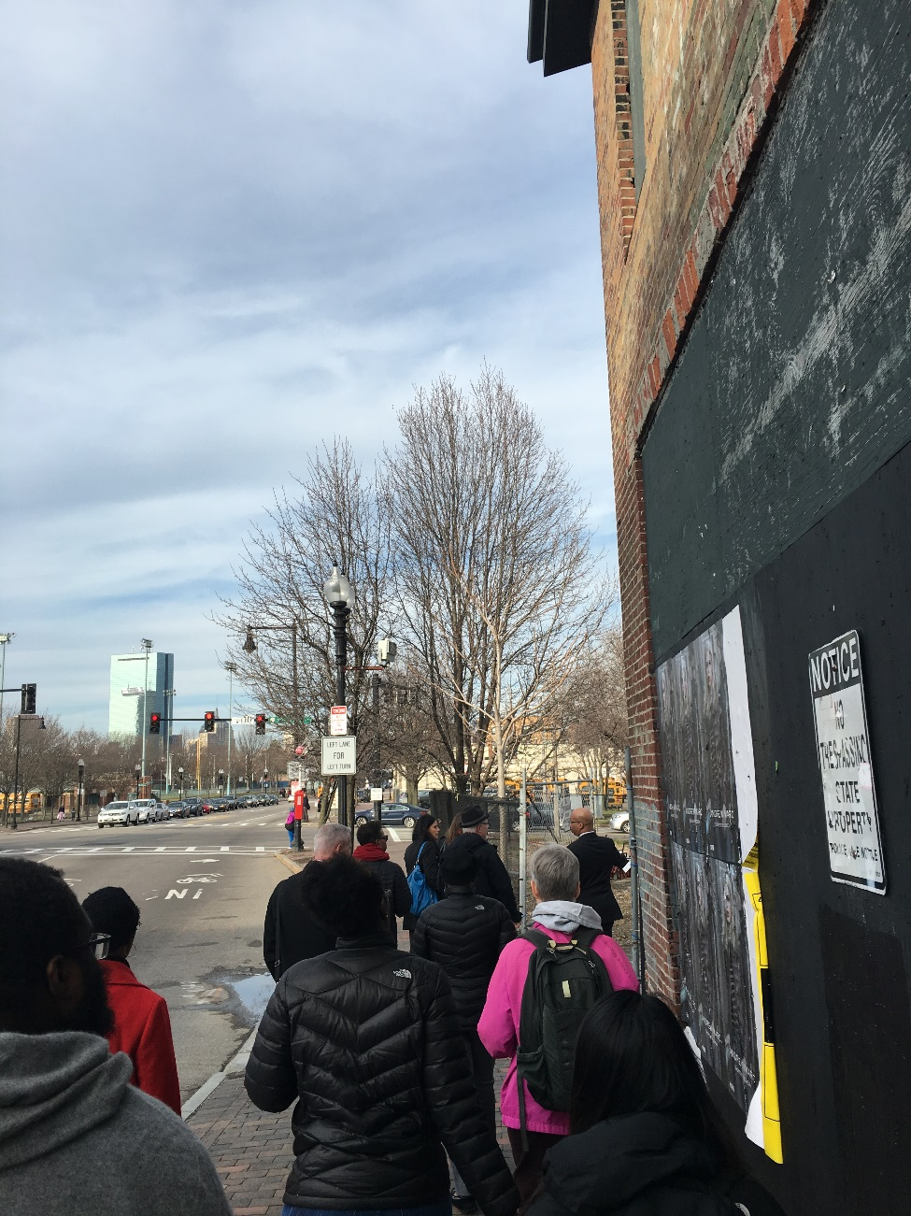
Walking tour comments
March 16, 2016
Physical planning must support people already here
Enhance space to support farmer's market by library (Dudley St. Commercial)
Make sure development doesn't divide neighborhood from other neighborhoods
Not many spaces in square for art and culture uses
Notes:
PLEASE ADD NOTES HERE. Thanks - CN

Slide 11
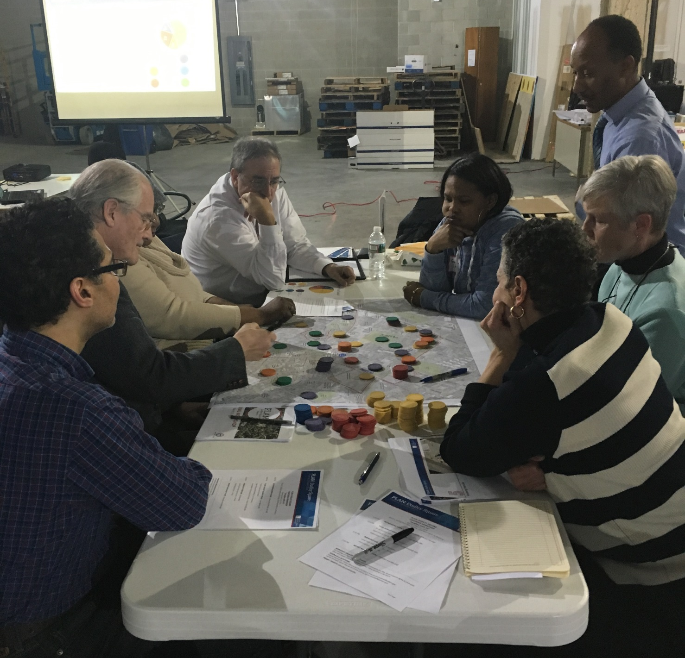
4
Visioning Workshop
Visioning Workshop
March 21, 2016
Notes:
CN – We can also opt for a photo that has people in it, not sure what people prefer.

Slide 12
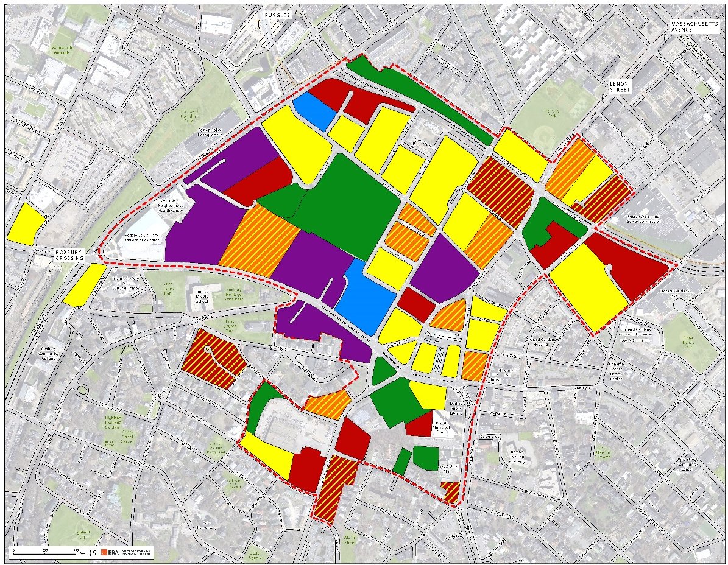
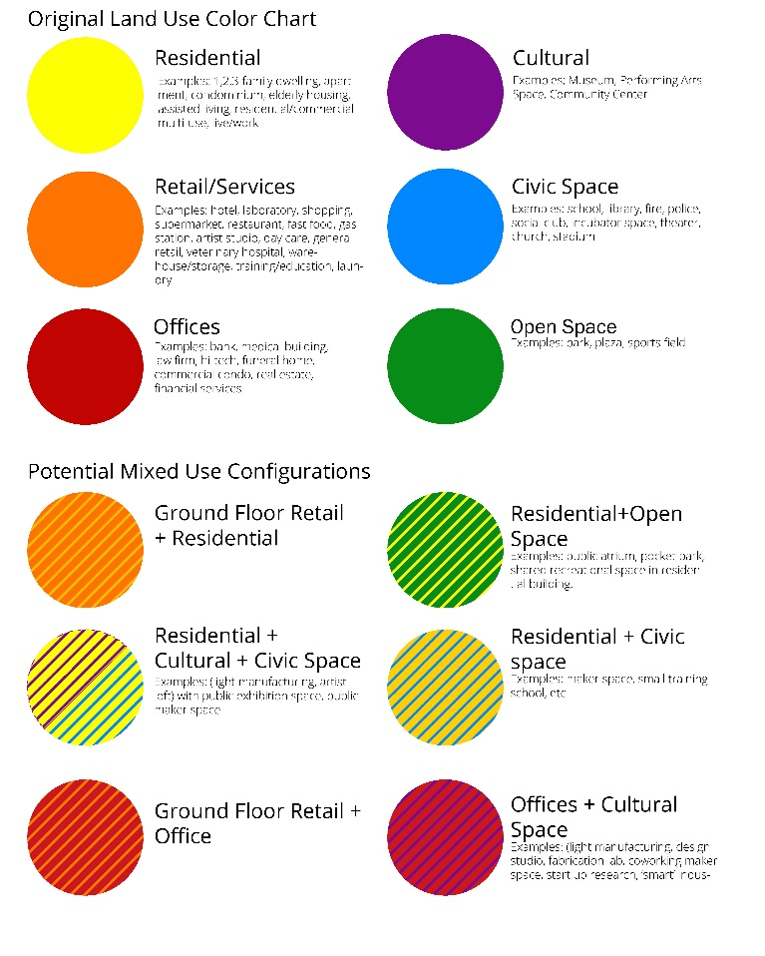
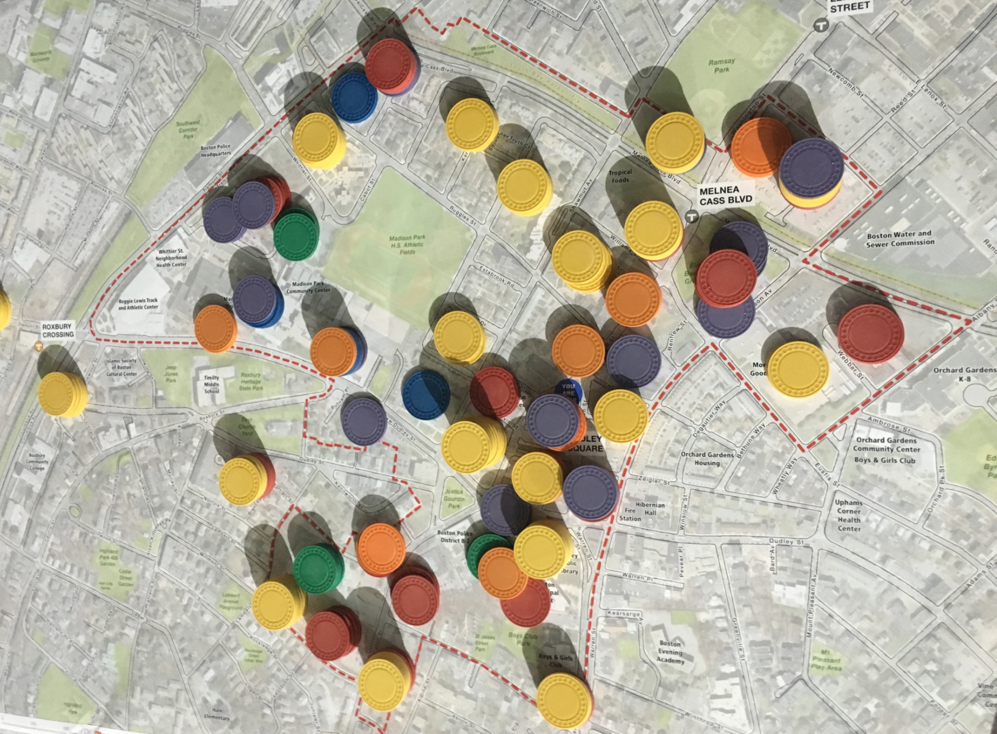
Table 1
Land Use Intensity Exercise
Preserve Madison Park area as residential
Preserve civic and cultural spaces along Malcolm X Boulevard including schools and the post office
Activate the existing open space in study area

Slide 13
PUBLIC REALM:
working definition for tonight
Streets, sidewalks, building setbacks, parks, plazas, building courtyards
Notes:
When we talk about mobility, we’re thinking about more than the movement of cars or the needs of people with disabilities. We use the term mobility to describe how everyone gets around – you might walk to the bus stop, go for a run with your dog, drive to the train station to pick up a friend, grab a Hubway, ride your bike to Franklin Park, or ride in a taxi/lyft/uber coming home from dinner. We care about how you move and how your neighbors move and want to facilitate you to take the trips you want to take.

Slide 14
PUBLIC REALM:
working definition for tonight
The Spaces Framed By Buildings
Notes:
When we talk about mobility, we’re thinking about more than the movement of cars or the needs of people with disabilities. We use the term mobility to describe how everyone gets around – you might walk to the bus stop, go for a run with your dog, drive to the train station to pick up a friend, grab a Hubway, ride your bike to Franklin Park, or ride in a taxi/lyft/uber coming home from dinner. We care about how you move and how your neighbors move and want to facilitate you to take the trips you want to take.

Slide 15
5
Citywide Overview of Transportation Planning and Trends

Slide 16
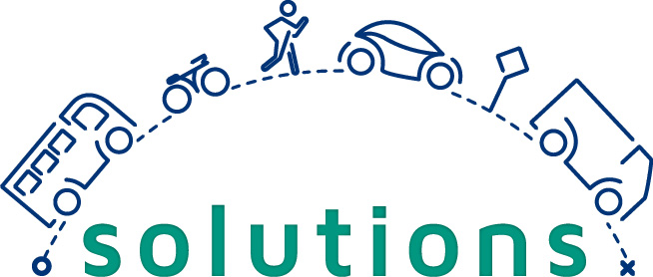
Present current land use and existing zoning
Transportation, mobility, and how you get around
WHAT IS MOBILITY
Notes:
When we talk about mobility, we’re thinking about more than the movement of cars or the needs of people with disabilities. We use the term mobility to describe how everyone gets around – you might walk to the bus stop, go for a run with your dog, drive to the train station to pick up a friend, grab a Hubway, ride your bike to Franklin Park, or ride in a taxi/lyft/uber coming home from dinner. We care about how you move and how your neighbors move and want to facilitate you to take the trips you want to take.

Slide 17
What’s going on in the Study Area?
Complete Streets
Go Boston 2030
Vision Zero
Greenlinks
Boston Bikes Plan
Notes:
Today we’ll be exploring how you get around the neighborhood study area today and you’ll have the opportunity to identify specific areas that could operate differently. We look forward to your feedback, but before we get there we want to give you a little bit of context for some other initiatives of the Boston Transportation Department that are already happening and affect the area.

Slide 18
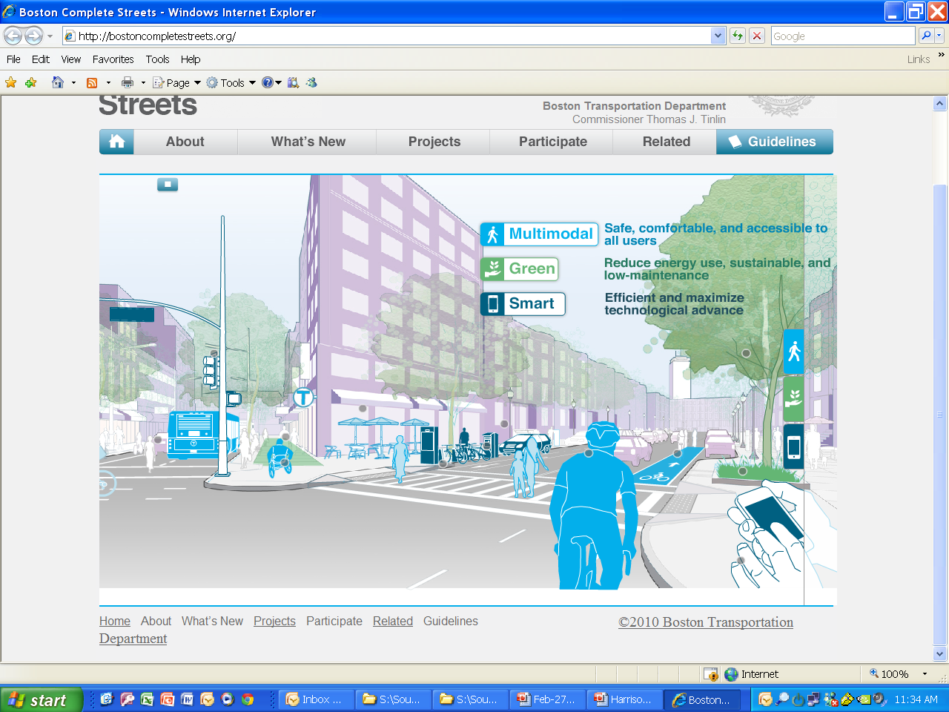
BOSTON COMPLETE STREETS
Notes:
Boston’s complete street guidelines were approved in 2013 and have since been used to guide all reconstruction and new construction on our city streets. Using the guidelines, streets include elements that are multi-modal (designed for more than cars), green (things like sustainably powered street lights and trees), and smart (leverage the power of technology from smart phones to signal timing).

Slide 19
GO BOSTON 2030
goboston2030.org
Notes:
Go Boston 2030 is our citywide mobility plan that is currently underway. Last winter we collected 5,000 questions about getting around Boston in the future. 600 people weighed in on potential goals and vision at the Visioning Lab last spring. This fall we collected about 3,000 project and policy ideas that we are in the process of evaluating. We hope that you will visit our website (goboston2030.org) to read the Vision Framework and the ideas we’ve collected and to stay involved in selecting projects for the Action Plan.

Slide 20
GO BOSTON 2030 - VISION
Go Boston 2030 envisions a city in a region where all residents have better and more equitable travel choices, efficient transportation networks that foster economic opportunity, and taken steps to prepare for climate change.
Whether traveling by transit, on foot, on a bike, or by car, Bostonians will be able to access all parts of the city safely and reliably.
Notes:
Go Boston 2030’s vision focuses on equity, economic opportunity, and responsiveness to climate change.

Slide 21
GO BOSTON 2030 - GOALS
Access Make Boston’s neighborhoods interconnected for all modes of travel.
Safety Collaborate on design and education to substantially reduce collisions on every street.
Reliability Prioritize making travel predictable on Boston’s transit and roadway networks.
Notes:
And Go Boston 2030 emphasizes goals and targets for access, safety, and reliability in addition to other goals and targets for six other themes.

Slide 22
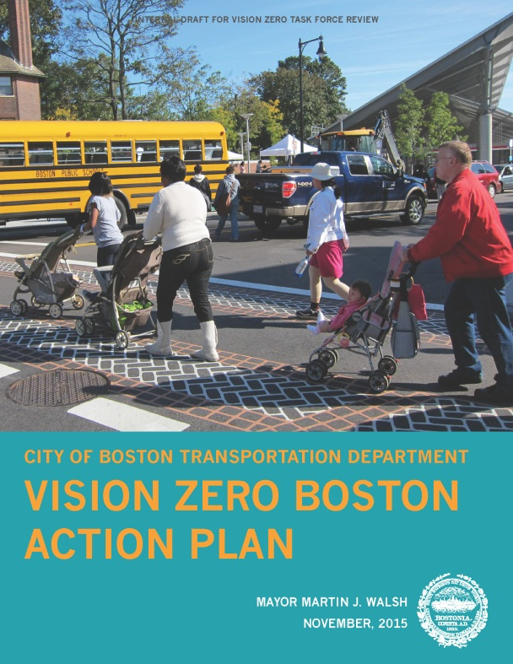
VISION ZERO BOSTON
visionzeroboston.org/input
Notes:
There were 79 traffic-related deaths on Boston’s streets between 2010 and 2014, prompting a demand for Vision Zero – an initiative aimed at eliminated these fatalities on our roadways through better designs and new policies. The action plan lays out four critical areas of focus and is already responding to the sites of recent crashes and fatalities. You can indicate where you feel unsafe walking, biking, or driving @

Slide 23
GREENLINKS
Notes:
Boston’s Greenlinks program is focused on connecting people to parks and paths on foot and on bikes. You can learn more about the existing and proposed greenways and connections on the BTD website. Green Street and Glen Road are proposed as a connection between Jamaica Pond and Franklin Park.
This review of BTD initiatives isn’t designed to limit your thinking tonight but to let you know the many things you can think about relating to mobility , which can fit into a larger context of connections through and across the city as well as the way the street in front of your house feels.
And if you have transportation ideas beyond the scope of tonight’s activities, you can connect with one of these projects to share additional ideas.

Slide 24
GREENLINKS
Notes:
Boston’s Greenlinks program is focused on connecting people to parks and paths on foot and on bikes. You can learn more about the existing and proposed greenways and connections on the BTD website. Green Street and Glen Road are proposed as a connection between Jamaica Pond and Franklin Park.
This review of BTD initiatives isn’t designed to limit your thinking tonight but to let you know the many things you can think about relating to mobility , which can fit into a larger context of connections through and across the city as well as the way the street in front of your house feels.
And if you have transportation ideas beyond the scope of tonight’s activities, you can connect with one of these projects to share additional ideas.

Slide 25
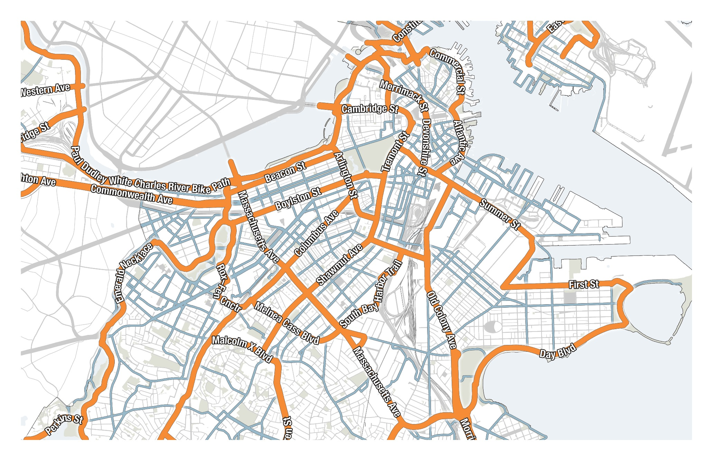
BOSTON BIKE NETWORK PLAN
Notes:
The 2013 Boston Bikes Network plan has a variety of facilities proposed for the study area. These include making Atherton, Green, and Glen safer for bikes within the next five years and improving Washington, Signourney, and Forest Hills Street for bikes further in the future.

Slide 26
BOSTON BIKE NETWORK PLAN
Notes:
The 2013 Boston Bikes Network plan has a variety of facilities proposed for the study area. These include making Atherton, Green, and Glen safer for bikes within the next five years and improving Washington, Signourney, and Forest Hills Street for bikes further in the future.

Slide 27
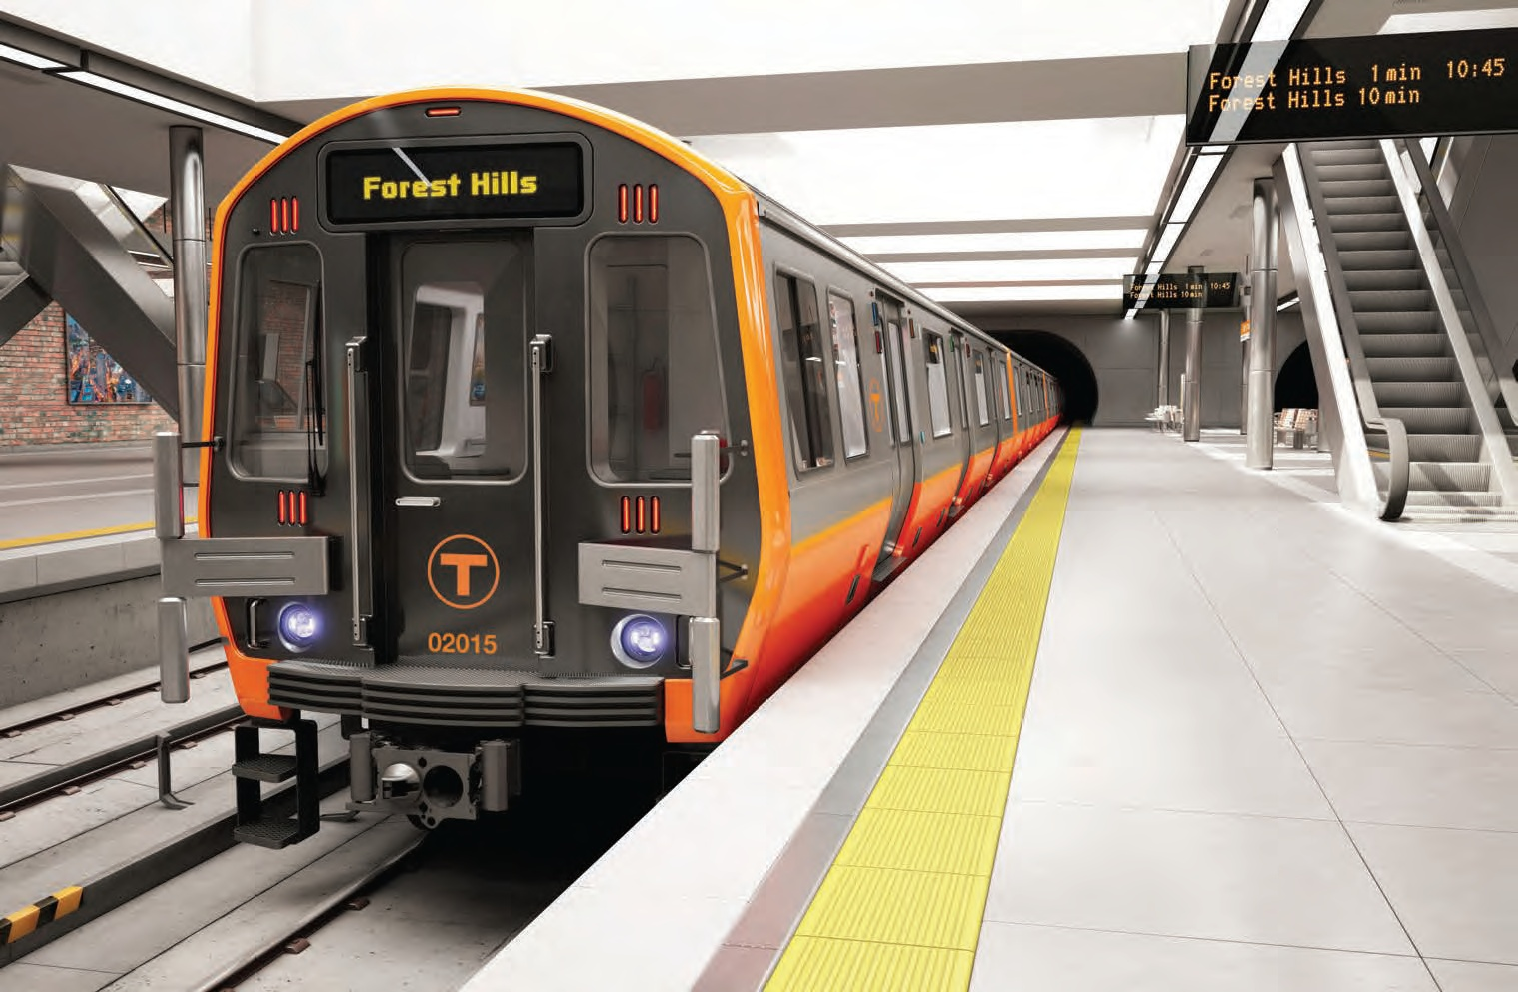
Orange Line Improvements
MBTA is procuring 152 new Orange Line vehicles replacing its current 120 vehicle fleet (an increase of 32 vehicles)
This will allow service in the peak periods to increase from every 6 minutes to every 4–5 minutes (an increase of 30-35%)
Delivery of the first pilot cars is expected to begin in 2018, and the full fleet will be available by 2023

Slide 28
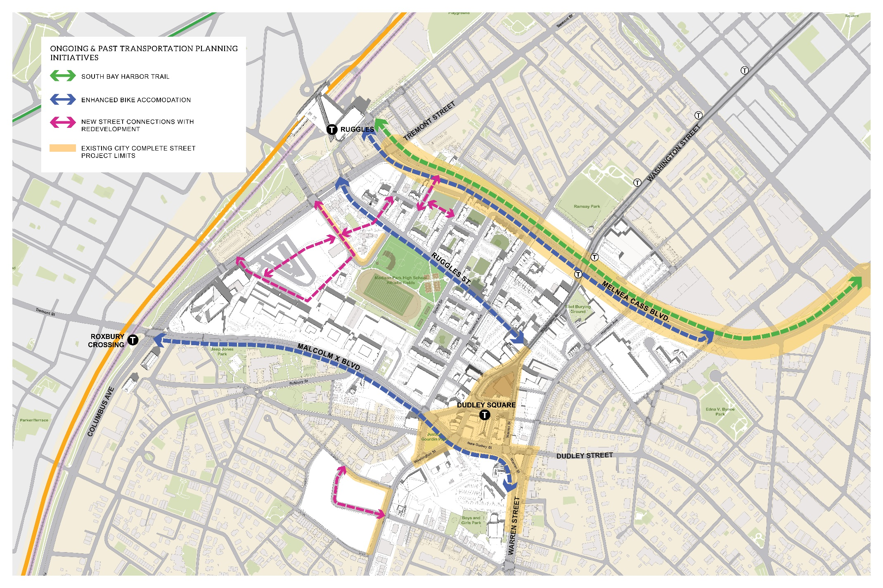
6
Ongoing & Past
Transportation
Planning
Notes:
CD – Image will be updated 4/15

Slide 29
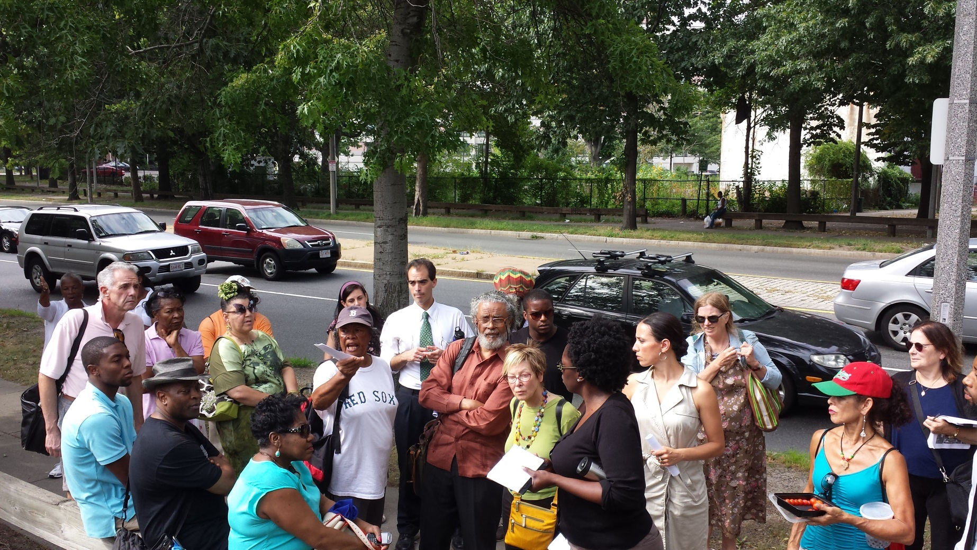
Ongoing and past transportation planning
Melnea Cass Boulevard Design Project
City design effort with state and federal earmark dollars for construction (TIP)
Design continuing to progress toward 25% with the help of the Friends Group and stakeholders (no road widening for BRT)
Refined concept now widens pedestrian and bike pathways instead of the roadway
City currently seeking additional funding in order to advertise for construction early 2018

Slide 30
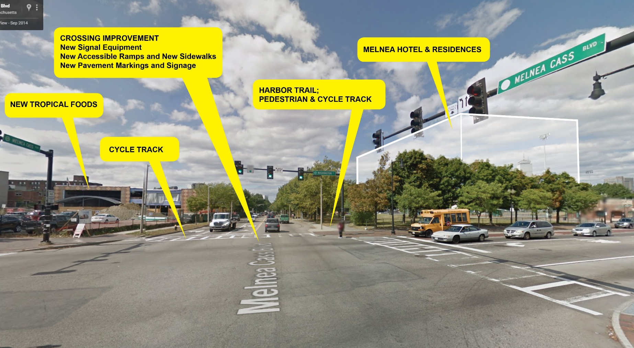
Ongoing and past transportation planning
Melnea Cass Boulevard Design Project
Priorities for Design:
Improve safety at intersections/ped crossings
Lower speeds
Enhance ped/bike connections and user experience along the entire corridor from Columbus to Mass Ave
Preserve existing tree canopy/add new trees and greenscape
Integrate planned development seamlessly
Notes:
CD – Image will be updated on 4/19

Slide 31
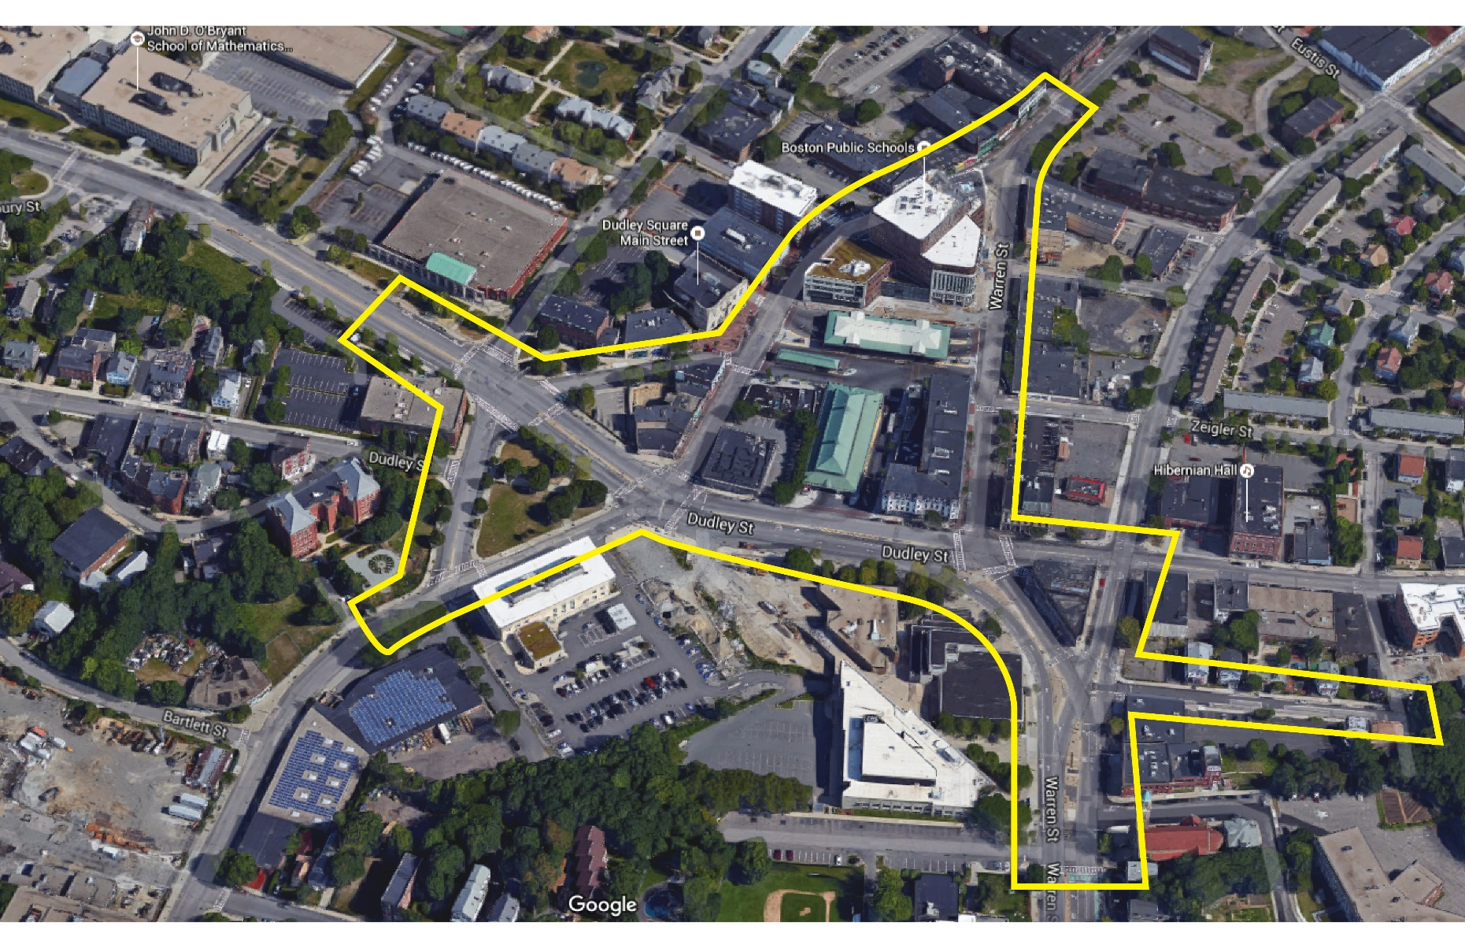
Ongoing and past transportation planning
Dudley Street Complete Streets
City design effort with City capital funding for construction
Six major intersections including roadway, streetscape and MBTA interface
New contract pending for resubmission of 25% design plans
Community process reboot this Spring
Targeted for construction Spring 2017 ($9 mil budgeted)

Slide 32
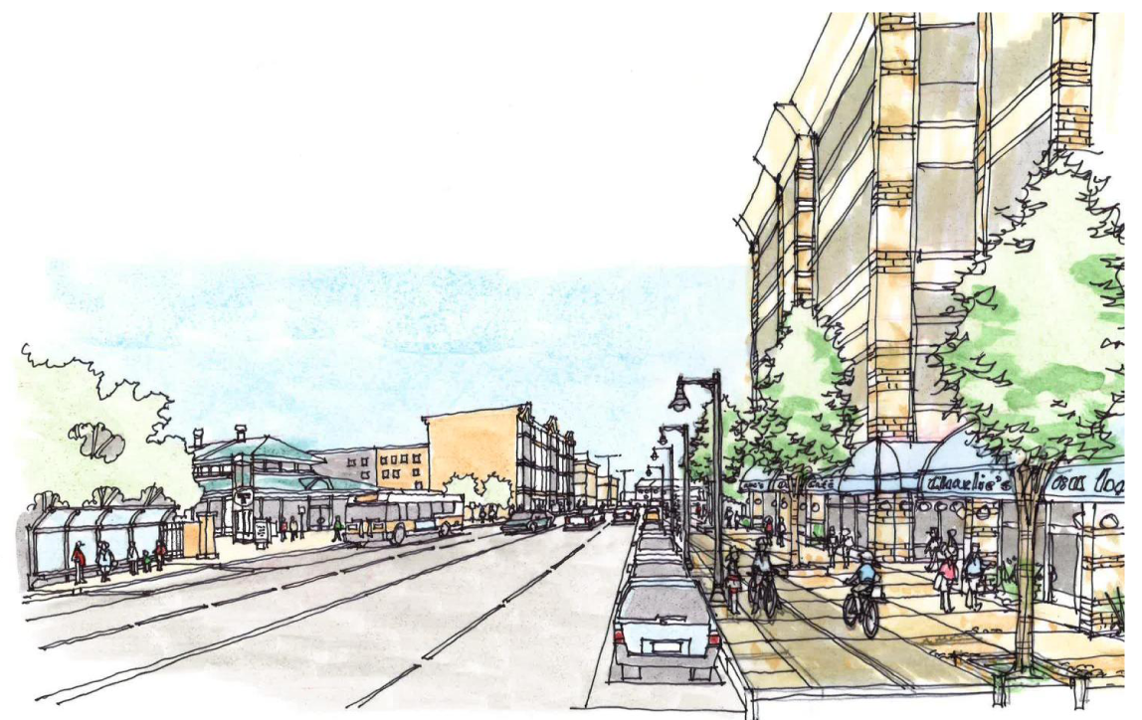
Ongoing and past transportation planning
Dudley Street Complete Streets
Priorities for Design:
Improve ped/bike experience & safety with wider sidewalks, shorter crossings and addition of grade separated cycle track
Relieve congestion/ improve bus operations with new signals and bus circulation plan
Green up with street trees and linear planters.
As with Melnea Cass, integrate planned development seamlessly

Slide 33
Ongoing and past transportation planning
Malcolm X Blvd Cycle Track
City/Boston Bikes led effort to design and construct a fully protected cycle track connecting SW Corridor & Roxbury Crossing T station to Dudley Square
Currently concept level design with need for community input and additional funding to advance project further

Slide 34
Ongoing and past transportation planning
Malcolm X Blvd Cycle Track
Priorities for Design:
Create parking protected two-way cycle track for safe, dedicated travel way
Preserve on street parking for the neighborhood and capacity for T buses and motorists
Link Hubway system, public transit, and existing/planned bike network

Slide 35
Ongoing and past transportation planning
Additional Past Transportation Planning by Others
Roxbury Dorchester Mattapan Transit Study (MassDOT)
Community driven process that culminated in recommendations for improving transit along the Blue Hill/Warren corridor into Dudley Square
Coordinated with City’s Dudley Vision and Dudley Complete Streets Project
Whittier Choice Neighborhoods (BHA/TACC)
“A Vision for Ruggles Street” component of the Whittier Neighborhood Transformation Plan
“Neighborhood Loop” concept plan
Splitting Up Superblocks and providing new connections through redevelopment (BRA)
Madison Park Project – Improved and new connections
BHA Whittier Project - New connecting roadway between Ruggles and Whittier Streets
Bartlett Yards - New connecting roadway

Slide 36
Notes:
CD – Image will be updated 4/15

Slide 37
Transportation planning in past RFPS
Ensuring the community’s vision
Promote adjacent streets as active pedestrian destination with attractive ground floor uses, pedestrian friendly streetscapes and sidewalks, and on-street parking.
Set-aside of dedicated parking spaces for shared vehicles (such as Zipcar) accessible to the general public (including local residents and businesses) is required.
Provide programs to encourage use of public transit, bicycling and walking for transportation including free or subsidized T passes, unbundling of parking from housing sales/leases, bicycling or walking bonuses and other strategies that discourage use of personal vehicles.
Parking ratio.
All service loading and unloading facilities should be located off-street and designed to prevent truck back-up maneuvers in the public right-of-way.
Transportation easements.

Slide 38
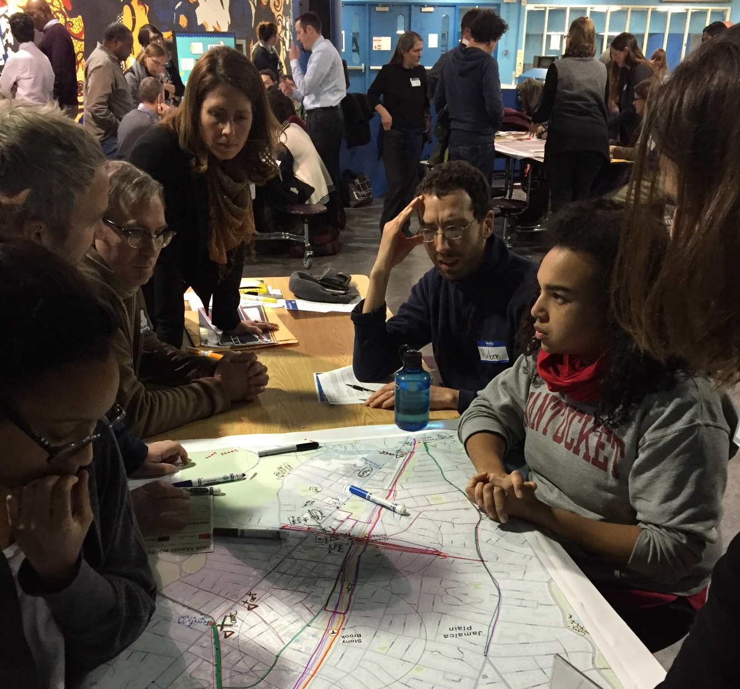
8
Transportation & Public Realm Exercise
Participants draw routes at PLAN JP/ROX workshop in Jamaica Plain
January 21, 2016
Notes:
CN – This photo is from JP/Rox, so note sure if we want to use it or not?

Slide 39
How we get around

Slide 40
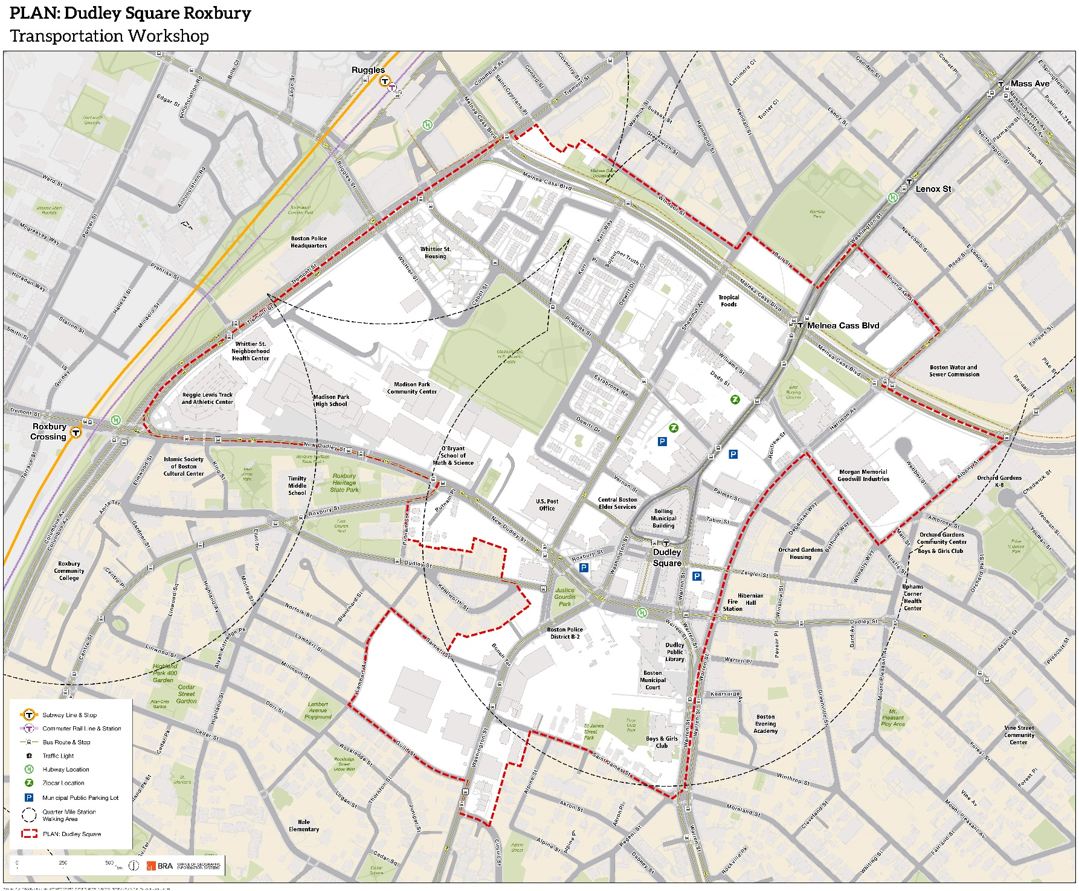
Mapping EXERCISE

