Slide 1
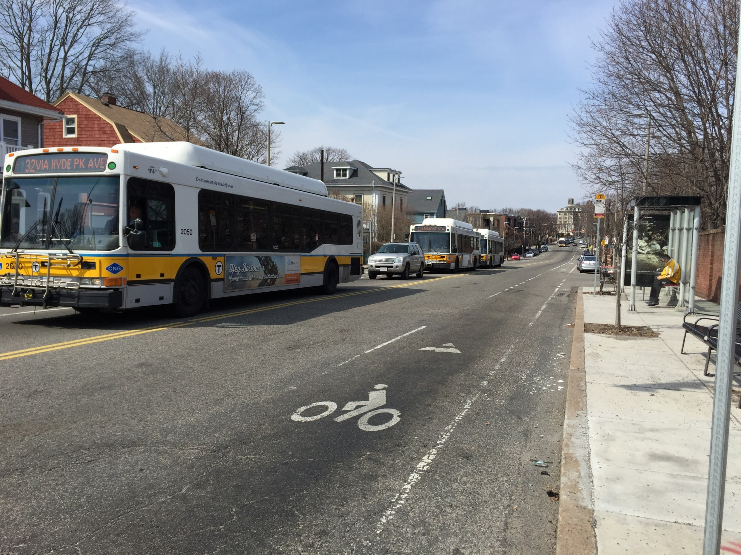
SOUTH HUNTINGTON AVENUE REZONING
May 21st, 2015
Hennigan Elementary School

Slide 2
Agenda
01. WHAT WE HAVE DONE?
Public process
Framework for Future Development Review (2013)
02. WHERE ARE WE TODAY?
Current conditions & outcomes since framework implementation
03. WHERE ARE WE GOING?
What is zoning?
What can be zoned?
What is the current zoning?
Where are we heading?
04. DISCUSSION
Build on the strength of the Framework
What have we missed?

Slide 3
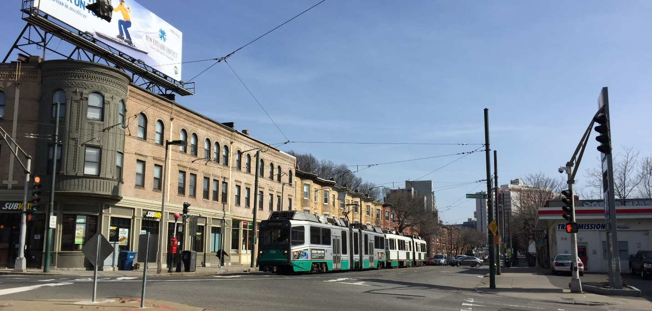
01
WHAT WE HAVE DONE?

Slide 4
Process

Slide 5
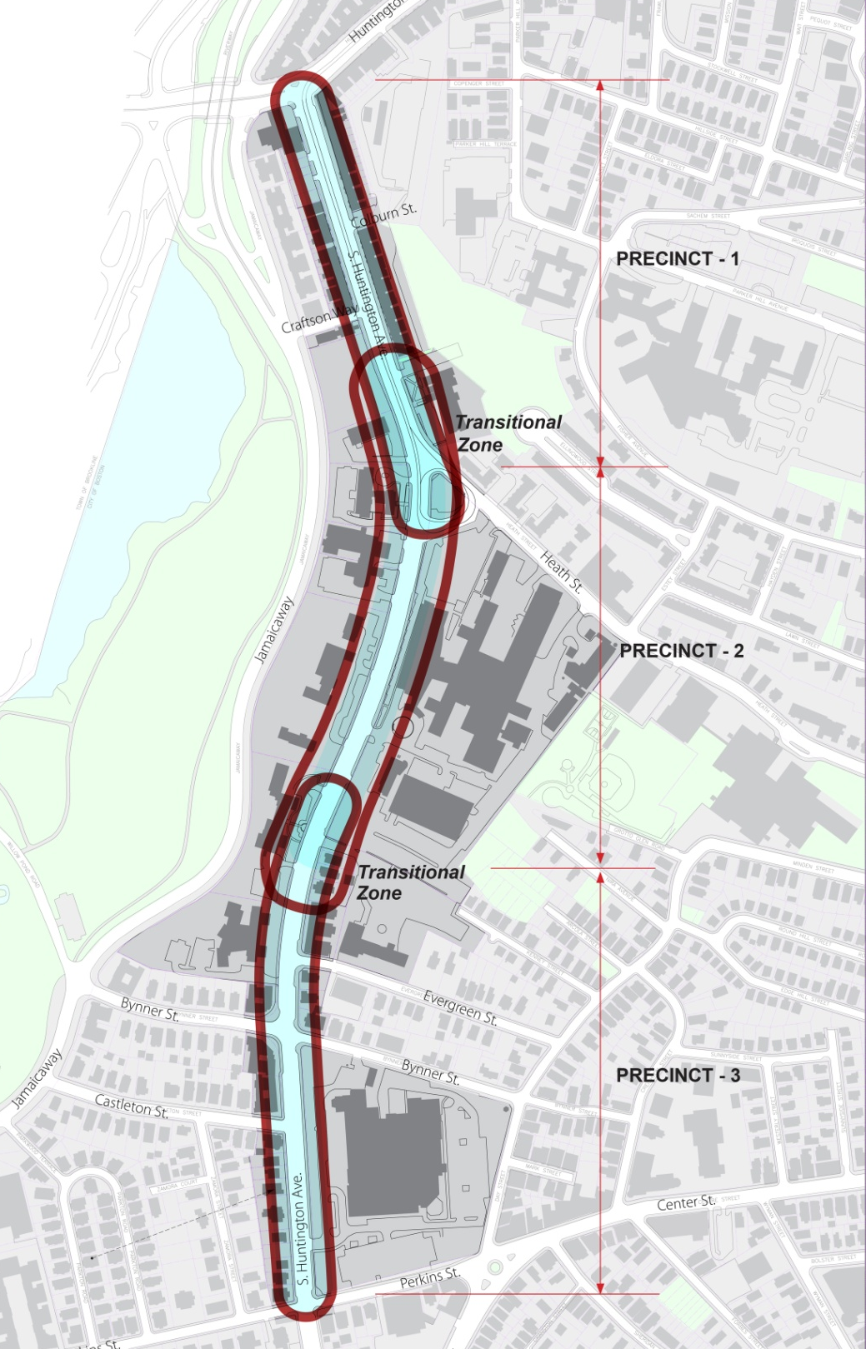
2013 Framework
Three Precincts
PRECINCT -1
Huntington Avenue to Heath Street
PRECINCT -2
Heath Street to Goddard House
PRECINCT -3
Goddard House to Perkins Street

Slide 6
2013 Framework
Overview
The Framework was developed with the Mission Hill and Jamaica Plain communities to establish consistency for development review within the South Huntington corridor, and included the following chapters:
Preferred Use Mix
Dimensional Guidelines
Transportation/Public Realm Guidelines
Implementation Chart

Slide 7
2013 Framework
Preferred Use Mix & Character
Existing or future institutional uses OK
Enhance existing character
Ground-floor local retail, residential, mixed-use
No-man’s land – where can I get a cup of coffee?
Vibrant street, pedestrian-friendly, some shops
Affordable retail space
PROMOTE economic investment into the neighborhood
Historic Preservation / Adaptive Reuse
Exceed minimum requirements of the Inclusionary Development Policy

Slide 8
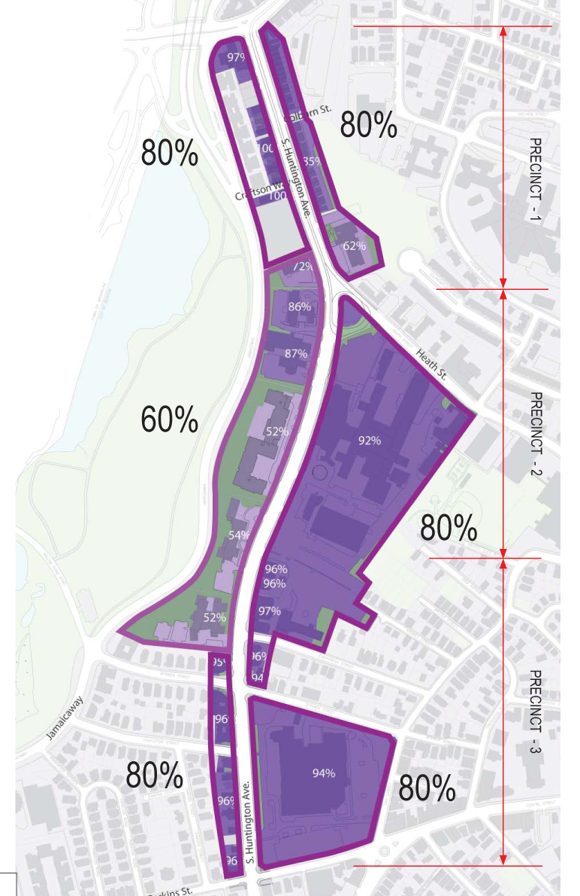
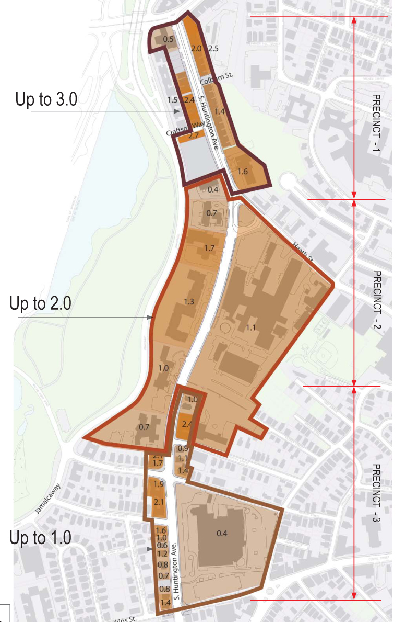
2013 Framework
Dimensional Guidelines
DEVELOPMENT FOOTPRINT – Existing & Guideline
FLOOR AREA RATIO – Existing & Guideline
Notes:
8

Slide 9
2013 Framework
Dimensional Guidelines
HEIGHT – Existing & Guideline
Notes:
9

Slide 10
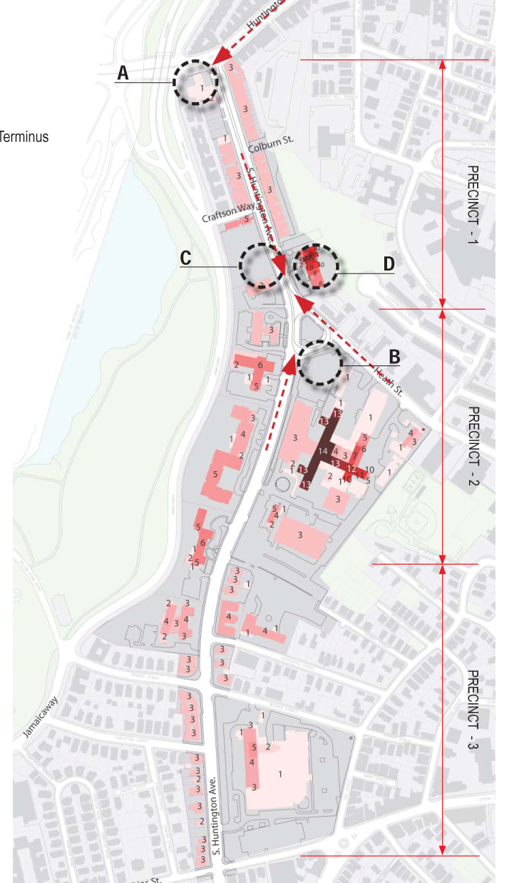
2013 Framework
Placemaking Opportunity Sites
Gateway
“Unique and Special”
Interesting architectural expression
Ground-floor active use
Public realm to attract gathering and pedestrians / refuge from street
Placemaking Opportunity Already Exits – Back of the Hill
(A)
Heath St Terminus Transitional zone
Transitional zone
Buffer zone
(B)
(C)
(D)
Notes:
10

Slide 11
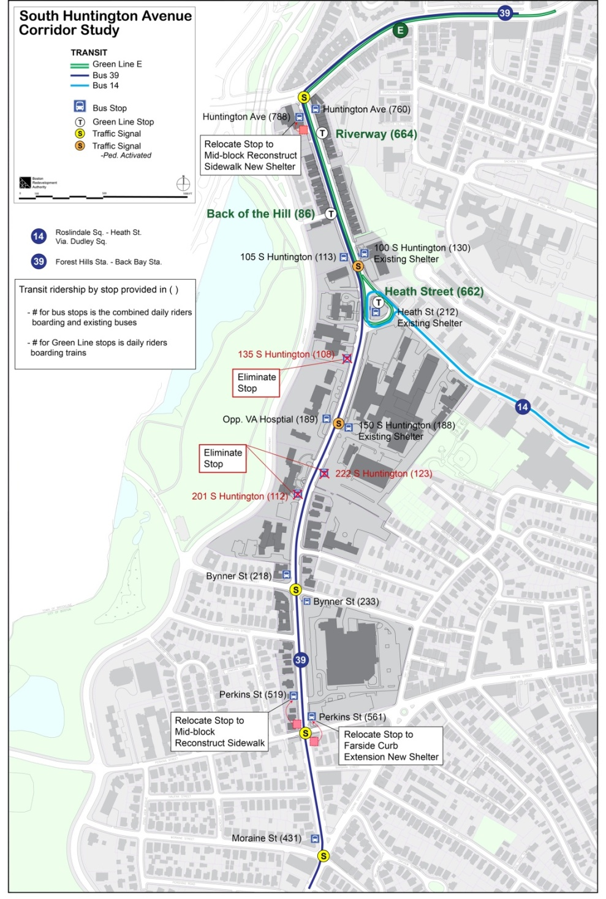
2013 Framework
Transportation
PUBLIC TRANSPORTATION
New projects to include a “transit impact analysis”
Improve passenger waiting areas
Businesses to provide transit pass subsidies
Contribute to corridor wide improvements
TRAFFIC MANAGEMENT
Traffic studies must include a more comprehensive network
Minimize site traffic demand by:
Car sharing services on site
Alternative modes of travel (transit, cycling, walking)
Sharing of parking spaces
Intersection improvements at Heath St & Huntington Ave
Contribute to corridor wide improvements
PARKING
Meet BTD parking ratios for the neighborhood:
Retail: 0.75/1,000 sf
Residential: 1.0/unit
Notes:
11

Slide 12
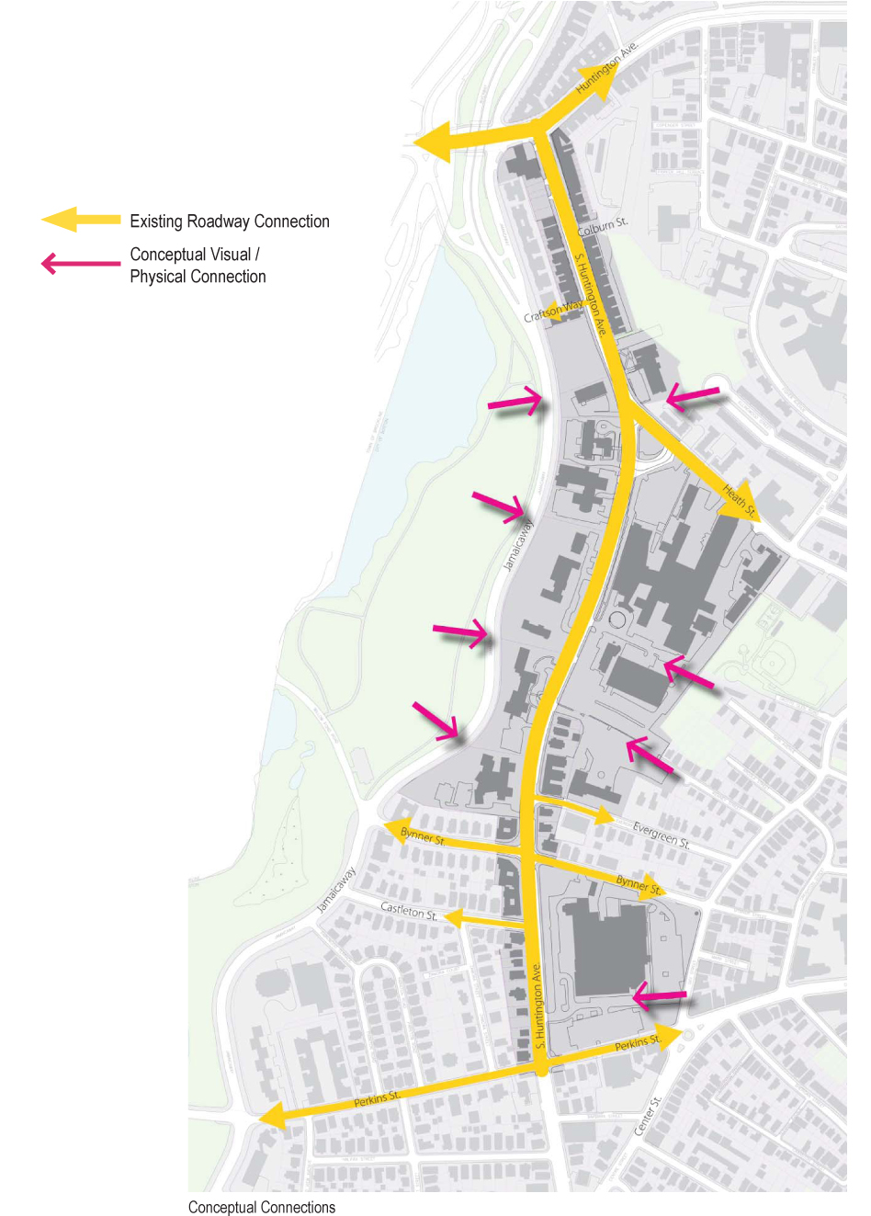
2013 Framework
Connectivity & Movement
CONNECTIONS
New through site connections
PEDESTRIANS
Widen sidewalks and/or accommodate a landscaped buffer at the front edge of development sites
Minimize auto-oriented needs (curb-cuts, parking, loading, drop off, vehicular circulation) in site frontage
Safe and clear on-site connections for pedestrians (especially through parking and vehicular circulation areas)
CYCLING
Safe and clear on-site connections for cyclists (especially through parking and vehicular circulation areas)
Meet current BTD bicycle parking ratios
Notes:
12

Slide 13
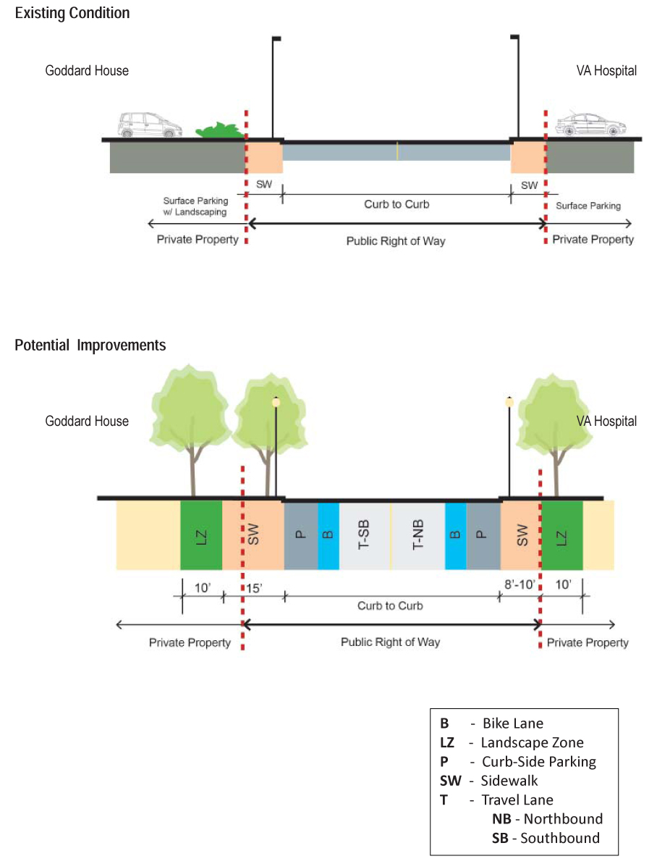
2013 Framework
FRAMEWORK FOR DEVELOPMENT REVIEW - TRANSPORTATION
Transportation
Complete Streets – Application Along South Huntington:
Development of a consistent tree/landscaping zone at back of sidewalk
Protect/improve on-road bike lanes
Provide widened sidewalks where desired
Enhance transit stops to improve conditions for waiting passengers
Upgrade light fixtures
Minimize/consolidate curb-cuts for driveways

Slide 14
2013 Framework
Implementation Table with Public Benefits
Notes:
14

Slide 15
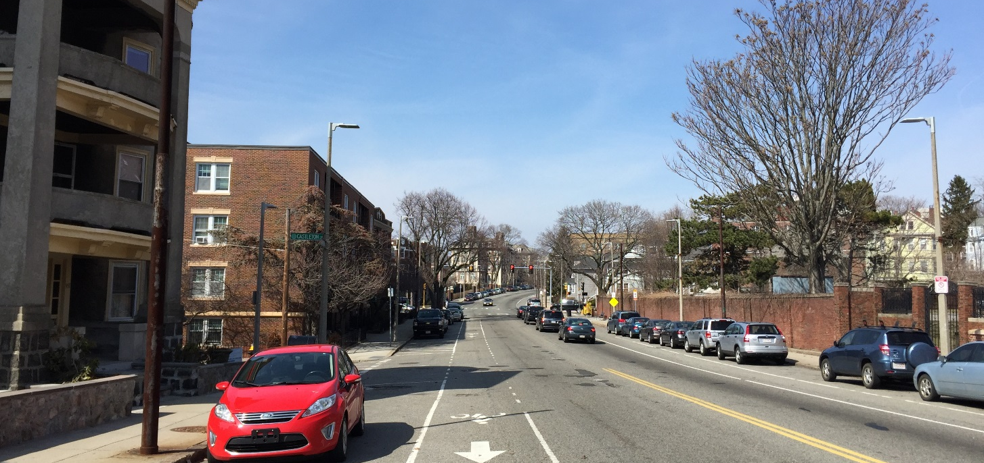
02
WHERE ARE WE TODAY?

Slide 16
Current Conditions & Outcomes Since Framework
2013 MBTA Key Bus Routes Improvement Program Changes:
Shelters, benches, trash cans, bus stop elimination, relocation and spacing

Slide 17
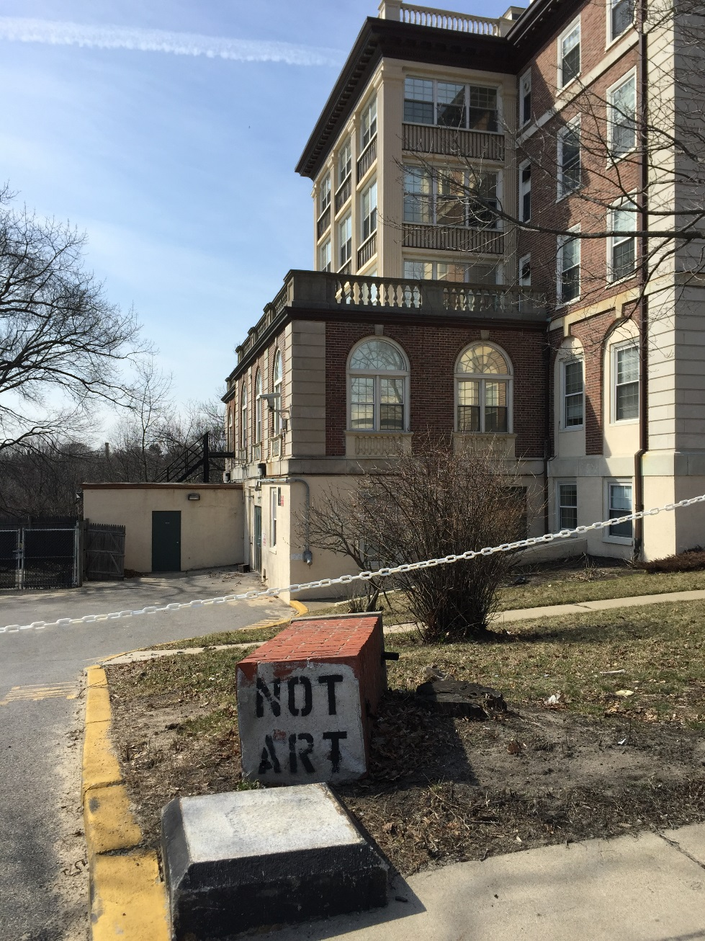
Current Conditions
Goddard House officially vacated

Slide 18
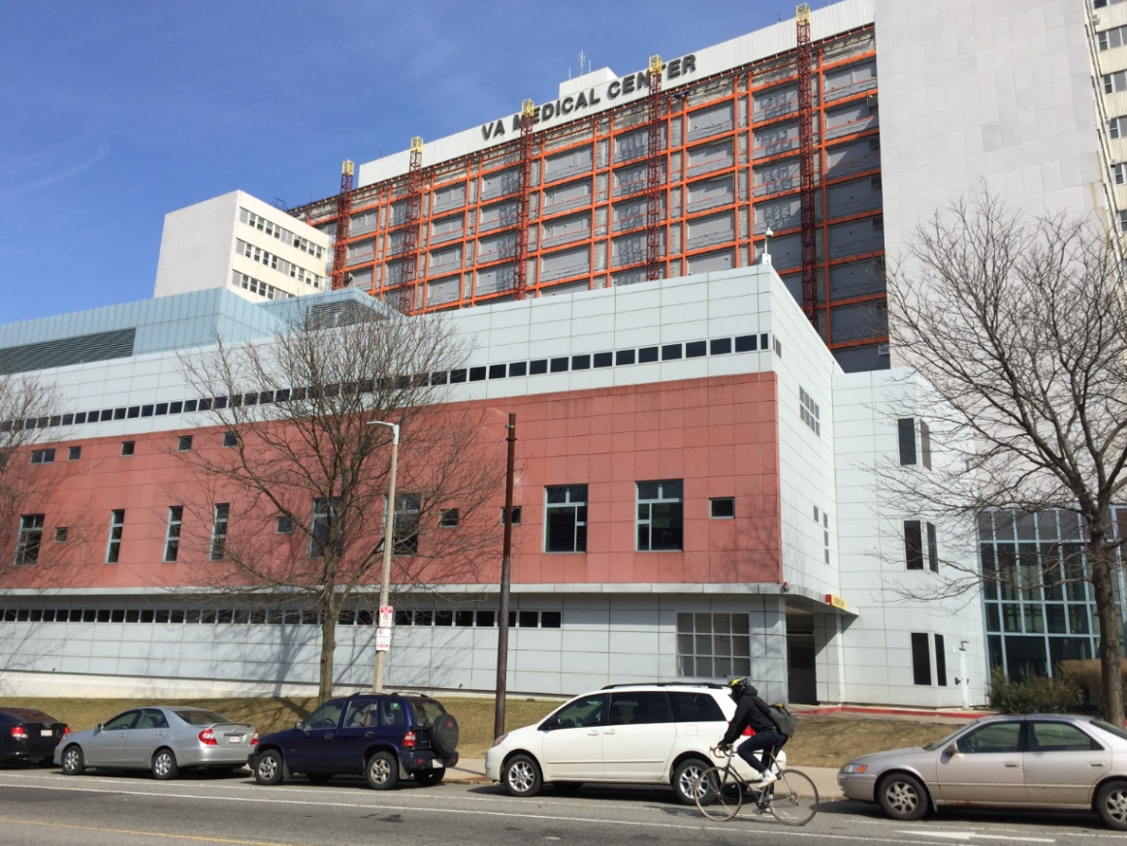
Current Conditions
VA standalone parking garage w/ armed gate entrance
Olmsted Place under construction
VA Façade Renovation

Slide 19
Outcomes since Framework Implementation
161 S. Huntington Avenue approved Nov 2012
-Under construction
- View corridor to Emerald Necklace through the lobby
105 S. Huntington approved June 2013
-Still on track
-Public Improvement Commission (PIC) approval in Feb 2015 for curb and sidewalk reconstruction, new and relocated specialty pavement, street lights, street trees, hydrants, driveways, retaining walls and electric vehicle charging stations
Key Routes (39 Bus) changes made
-Shelters, benches, trash cans, bus stop elimination, relocation and spacing
New discussions with MSPCA re: wall via Boston Transportation Department’s (BTD) “JP/South/Hyde/Jackson Design Projects”

Slide 20
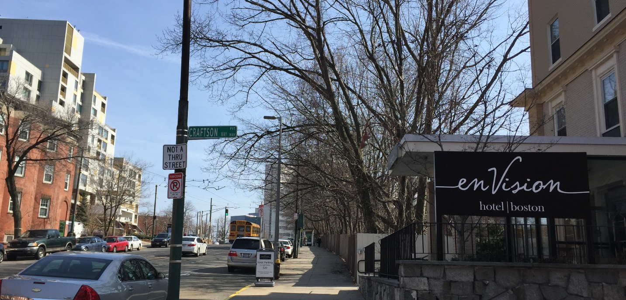
03
WHERE ARE WE GOING?

Slide 21
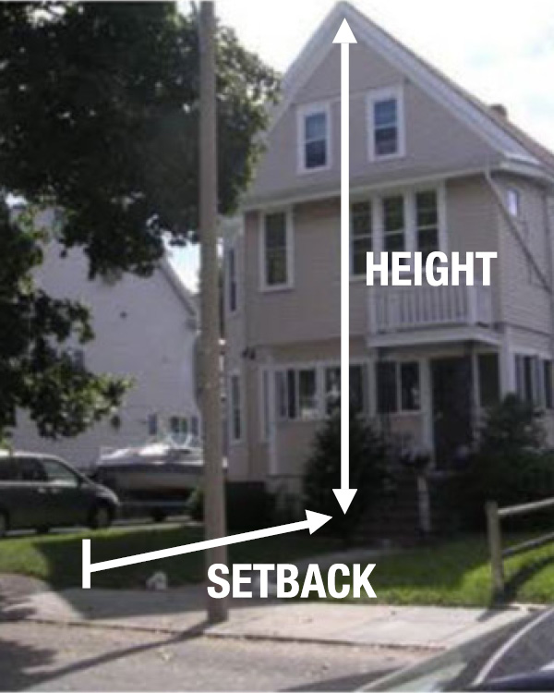
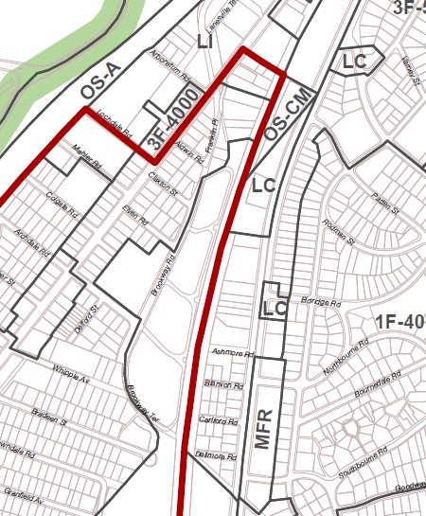
What is Zoning?
What Can Be Zoned?
Type of Uses – residential, commercial, industrial, etc.
Dimensions
Size, Form & Scale – height, massing, lot size, setbacks, open space requirements, building footprint, etc.
Design guidelines and requirements
Sign Requirements
Parking and loading requirements

Slide 22
What is Zoning?
Zoning Also Determines Review Process:
Forbidden Use: Hearing before Zoning Board of Appeals (with higher bar to overcome)
Conditional Use: Hearing before Zoning Board of Appeals
Allowed Use: No public hearing required. Administrative permits may be required.

Slide 23
What Is The Current Zoning?
 | Zoning District
Mission Hill Article 59 | NS
 | RH
 | MFR-2
Jamaica Plain Article 55 | NI (VA)
 | NI (MSPCA)
 | 2F-5000

Slide 24
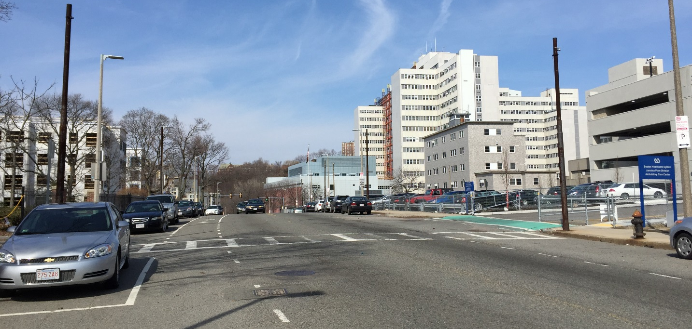
04
DISCUSSION

Slide 25
How To Stay In Touch With Us
Marie Mercurio, Jamaica Plain Planner
marie.mercurio@boston.gov
(617) 918-4352
Ted Schwartzberg, Mission Hill Planner
ted.schwartzberg@boston.gov
(617) 918-4238
BRA Project Website
http://www.bostonredevelopmentauthority.org/planning/planning-initiatives/south-huntington-avenue-corridor-study
BRA Community Meeting Calendar
http://www.bostonredevelopmentauthority.org/news-calendar/calendar

