Slide 1
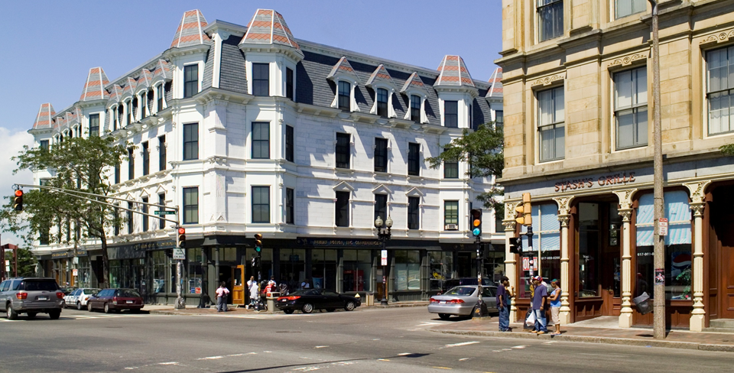
ROXBURY STRATEGIC MASTER PLAN OVERSIGHT COMMITTEE MEETING
November 4, 2024

Slide 2
RSPMOC
WELCOME AND ORIENTATION

Slide 3
MEETING RECORDING
At the request of community members, this event will be recorded posted on the Roxbury Strategic Master Plan webpage at bit.ly/theRSMPOC for those who are unable to attend the Zoom event live.
Also, it is possible that participants may be recording the meeting with their phone cameras or other devices. If you do not wish to be recorded during the meeting, please turn off your microphone and camera.
If your camera and microphone are off, you can still participate through the text chat feature.

Slide 4
INTERPRETATION
“Spanish” –for Spanish
“Haitian Creole” –for Haitian Creole
“English” – for English
“Cape Verdean Creole” - Cape Verdean Creole

Slide 5
ZOOM TIPS
Welcome! Here are some tips on using Zoom for first-time users.
Your controls are at the bottom of the screen
Use the chat to type a comment or ask a question at any time –
Members of the RSMPOC/ BPDA will moderate the chat
To raise your hand, click on “Participants” at the bottom of your
screen, and then choose the “Raise Hand” option in the participant box, or press *9 on your phone
Mute/unmute – Participants will be muted during the presentation – the host will unmute you during discussion if you raise your hand andit is your turn to talk. To mute/unmute on your phone press *6.
Turns your video on/off

Slide 6
ZOOM ETIQUTTE
We want to ensure that this conversation is a pleasant experience for all attendees.
Please remain muted until called on. If you’d like to speak during this time please use the “Raise Hand” function in Zoom so a BPDA moderator can unmute attendees.
Please be respectful of each other’s time.
We ask that participants limit their questions so that others may participate in the discussion. If you have more questions, please wait until all others attending have an opportunity to ask questions.
If we are unable to get to your question at this meeting please put them in the Chat at the end or email christine.brandao2@boston.gov

Slide 7
AGENDA
RSMPOC Welcome
Devin Quirk & Rebecca Tomasovic - Planning Department Update

Slide 8
RSMPOC OVERVIEW AND UPDATES
First Monday of the month
January 8, 2024 ​
February 5, 2024​
March 4, 2024
April 1, 2024
May 6, 2024
June 3, 2024
July 1, 2024
**No Meeting in August** ​
September 9, 2024​
October 7, 2024
November 4, 2024​
**No Meeting in December**

Slide 9
RSMPOC RESPONSIBILITIES
The Roxbury Strategic Master Plan Oversight Committee (RSMPOC) was created in 2004 as a result of the Roxbury Strategic Master Plan (RSMP).
The RSMPOC is broadly representative of the Roxbury neighborhood and is made up of Mayoral Appointees, nominated by elected officials, neighborhood associations, and community organizations.
The RSMPOC oversees the implementation of the Roxbury Strategic Master Plan and PLAN: Nubian Square.

Slide 10
JOIN. ENGAGE. TAKE ACTION
Join: Join the Roxbury Strategic Master Plan Oversight Committee, and/or a Project Review Committee (PRC).
Engage: Attend public meetings. Ask questions. Invite neighbors, Roxbury civic groups and organizations, businesses, abutters or other community affiliates to public meetings.
Take Action: Review and comment on projects, developments, and the planning initiative.
For more information about upcoming meetings, development projects and how to get involved, visit bit.ly/theRSMPOC

Slide 11
ORIGINAL 2004 MASTER PLAN GOALS
Enhance civic & cultural life in the neighborhood
Promote diverse & sustainable growth with jobs for local residents
Ensure safe & convenient public and private transportation
Expand & improve housing for a variety of socioeconomic and age groups
Create a comfortable, lively, and safe public realm that reflects the diversity of local residents
Enhance community participation and empowerment through increased accountability of government, and institutions and businesses
Source: Roxbury Strategic Master Plan, p.4

Slide 12
2. Devin Quirk & Rebecca Tomasovic - Planning Department Update

Slide 13
“In this moment of need, we have an opportunity and an obligation to change how we plan for Boston’s future. We’re charting a new course for growth, with people as our compass.”
Mayor Michelle Wu
January 25, 2023
State of the City Speech

Slide 14
TRANSFORMATION OVERVIEW
New Agency with a new charter, mission, and goals to rise to today’s needs.
Change how we Plan for Growth:
Zoning reform to make development more predictable and tied to comprehensive planning
Design vision to shape how future spaces are designed
Article 80 modernization for stronger transparency and predictability around development
Public land for public good in our real estate transactions
1
Restructure Planning with City Government:
Create a Planning Department within the City of Boston through City Council Ordinance, restoring planning as core function of city government
Majority of BPDA staff and finances move to City control on July 1, 2024
Planning Advisory Council to coordinate citywide planning and implementation
2
Repurpose BPDA Tools/Powers via State Legislation:
Home Rule Petition - abolishes the BRA’s urban renewal era focus on blight and decadence
Replace with tools for affordability, resilience, equity
The HRP passed City Council in March and is now at State House
3
Notes:
This vision will be realized through legislation, executive orders, and staff level action, so that we are both setting bold long term goals and acting with urgency now

Slide 15
Article 80 Improvement Project

Slide 16
WHAT IS ARTICLE 80?
“Article 80” is a section of the Boston Zoning Code. It governs procedures related to the regulatory review of development projects. Currently, these procedures apply to projects that include at least 15 units of housing, or are larger than 20,000 square feet.
Development Review brings together various stakeholders to collectively assess the impacts of development projects and to determine the appropriate mitigation
and community benefits.

Slide 17
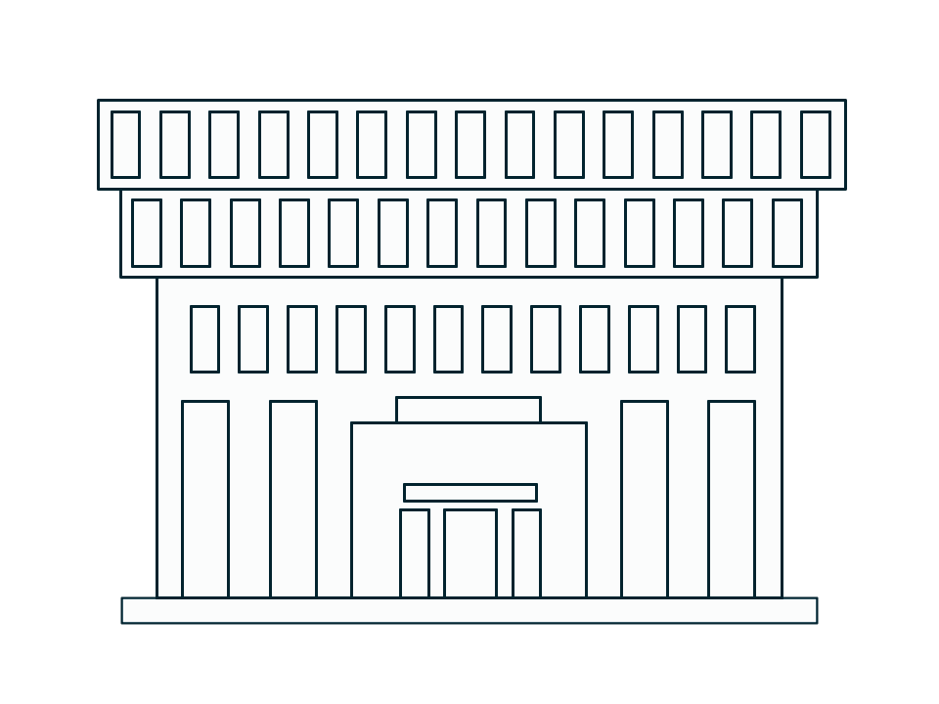
IMPROVING OUR DEVELOPMENT REVIEW PROCESS
Why are we doing this now?
Community members, developers, and staff all agree that the Planning Department’s Article 80 development review process is outdated, unpredictable, and lacks transparency.
Mayor Wu, in her 2023 State of the City speech and Executive Order, charged the Planning Department with creating and implementing a reformed development review process that improves how communities, developers, and the Planning Department work together to shape the city.
Article 80 Modernization is an effort led by the Planning Department to review, analyze, and recommend improvements to the technical code, operations, and community engagement practices related to our development review process.

Slide 18
PROJECT TIMELINE
2023
2024
2025
Jul
Aug
Sep
Oct
Nov
Dec
Jan
Feb
Mar
Apr
May
Jun
Jul
Aug
Sep
Oct
Nov
Dec
Jan
Feb
Mar
Apr
PHASE 1: ISSUE IDENTIFICATION
through engagement, peer cities research, and existing conditions analysis
PHASE 2: DRAFT RECOMMENDATIONS
through continued engagement
PHASE 3: CONTINUED ENGAGEMENT, DUE DILIGENCE, PHASED IMPLEMENTATION
PROJECT SCHEDULE
ENGAGEMENT
ENGAGEMENT KEY
Community Stakeholders
Development Community
A80 Steering Committee
City Leadership and Electeds
City Staff
Survey
Direct engagement

Slide 19
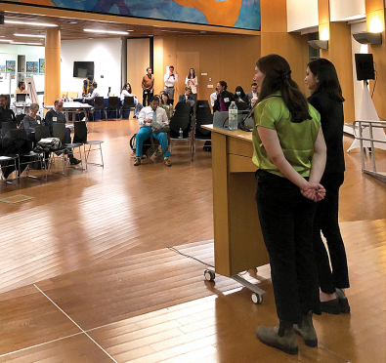
COMMUNITY AND STAKEHOLDER ENGAGEMENT
PHASE 1
2,600 survey responses (across 4 surveys)
50+ focus groups (IAG members, developers, institutions, labor, city staff, advocates, civic groups, community members)
2 public meetings (in person and Zoom)
18 Steering Committee meetings
IAG Member outreach
220+ specific survey responses
4 dedicated focus groups
PHASE 2
Focused on detailed feedback on draft recommendations
10 workshops. 8 in-person held across the City and 2 virtual
230 survey responses
11 focus groups (IAG members, developers, institutions, labor, city staff, advocates, civic groups)
City Council Hearing
Broad Outreach
Digital outreach campaign
In-person flyering citywide
Brighton
Downtown
Dorchester
South Boston
Fenway
East Boston
Roslindale
Roxbury

Slide 20
COMMUNITY AND STAKEHOLDER THEMES
THEMES FROM COMMUNITY ENGAGEMENT
The engagement process does not communicate clear goals
The role and structure of advisory groups should be reviewed and clarified
The mitigation and community benefits process is confusing and inconsistent
77%
27%
82%
of existing participants would like more options for engagement
of community participants understand how their input is currently used
of community participants said that the BPDA should adopt a more standardized mitigation approach
Notes:
“There is typically no agenda issued in advance, nor discussion of what needs to be decided and how decisions will be made… The result is that each meeting regurgitates the same issues every time, rather than advancing a set of issues and goals that are clear and which people can work towards, eventually moving to next steps. This discourages participation.” Community member
“What IAG members are supposed to do and how an IAG should function is very unclear and rarely if ever addressed. There appear to be no public expectations set by the BPDA for IAG member participation.” Community member
“There is no guidance from the BPDA as to what constitutes appropriate community benefits and what the goals of negotiating community benefits should be.” Community member

Slide 21
PROJECT HIGHLIGHTS
Article 80 Modernization is creating a more predictable and transparent development review process for all stakeholders
What does this mean?
Earlier and more equitable engagement
Predictable costs and timelines
Transparent decisions and clear feedback loops
Major project milestone
Article 80 Draft Action Plan was released on September 25
Comments will be collected through the end of November
Project Website www.bostonplans.org/projects/improving-development-review-process-article-80

Slide 22
DRAFT RECOMMENDATIONS | CORE CHANGES
EFFECTIVE
ENGAGEMENT
Diversify Input in Development
By expanding community participation opportunities
1A. Create more opportunities to learn about projects and easier ways to provide feedback, such as online surveys
1B. Replace current advisory groups with Community Advisory Teams (CATs), a new structure that will represent Boston’s diversity, while retaining existing expertise
01
Take the Fight Out of Approvals
By standardizing mitigation and community benefits
2A. Write new definitions for community benefits and mitigation
2B. Establish clear dollar-per-square-foot policies for transportation
& infrastructure and open space & public realm impact mitigation
2C. Create stronger connections between recent planning and
community benefits
2D. Require proponents to file a new disclosure on displacement impacts
CONSISTENT STANDARDS
02
Prevent 3 Steps Forward 2 Steps Back
Through a transparent, sequential and coordinated approval process
3A. Formalize the pre-file process and align filing sequence with industry
practices
3B. Lock in key decisions early through a “Initial Adequacy Determination” that can provide a clear and early “no” to inadequate proposals
3C. Update and enforce response times
3D. Create interdepartmental portfolio review teams and enhance data-driven performance monitoring
COORDINATED REVIEW
03

Slide 23
Zoning Reform and Design Vision

Slide 24
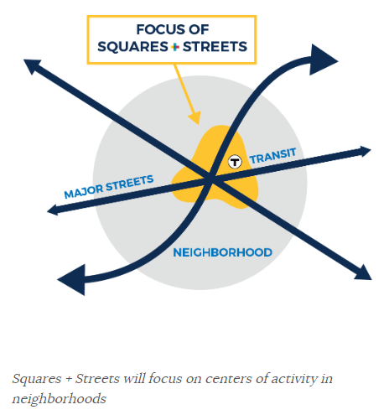
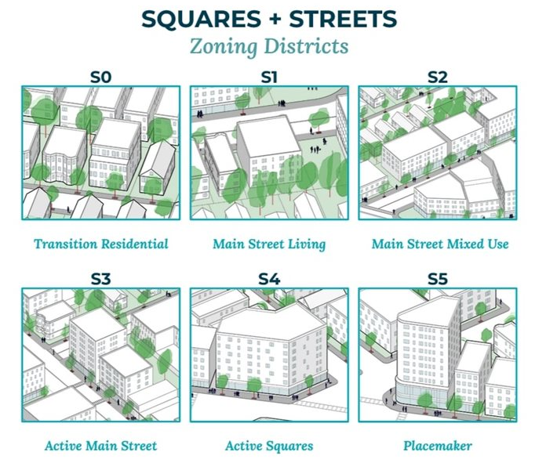
SQUARES + STREETS OVERVIEW
Squares + Streets is a planning and zoning initiative focused on adding, supporting, and improving housing, public space, small businesses, and arts and culture in transit-accessible neighborhood centers and along main streets.
Squares + Streets zoning amendments will be one of the first steps toward shaping citywide zoning reform to respond to an ongoing housing crisis. Squares + Streets plans will focus on small geographies and recommendations that can be implemented within 5-10 years.
Current Squares + Streets initiatives underway include:
Roslindale Square
Cleary Square
Codman Square + Four Corners
Fields Corner
Read more about the Squares + Streets here: https://www.bostonplans.org/planning-zoning/planning-initiatives/squares-streets#about
For more information contact: squaresandstreets@boston.gov

Slide 25
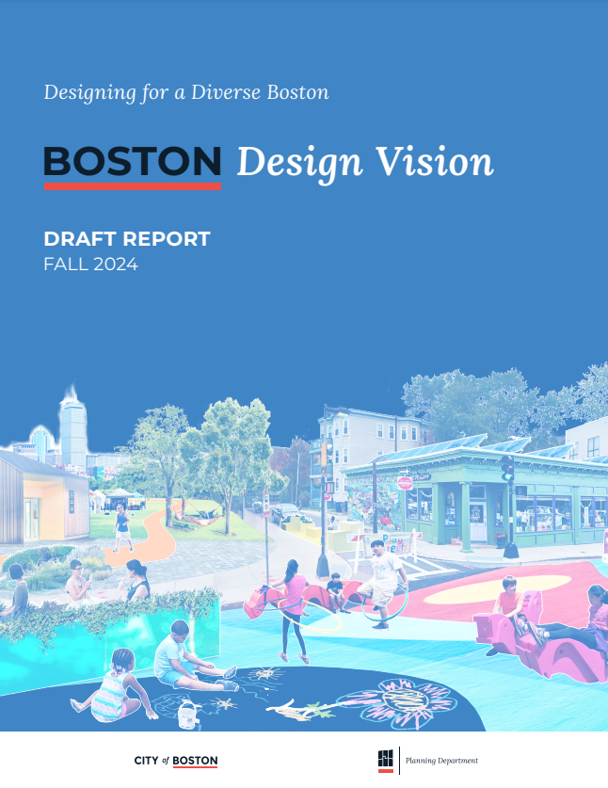
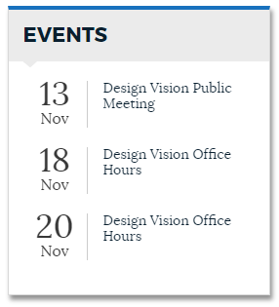
DESIGN VISION OVERVIEW
The Boston Design Vision seeks to understand how buildings and outdoor spaces can better support Bostonians' sense of belonging and identity citywide.
The Design Vision is a statement of the principles we commit to uphold as design professionals working on behalf of every Bostonian to elevate the quality of design in our city.
We aim to shape public and private projects that will:
relate to their unique context and reflect the diversity of Boston's communities,
ensure the sustainability and resiliency of our communities, and
contribute positively to the world around them
Read more about the Design Vision here: http://www.bostonplans.org/urban-design/urban-design-initiatives/boston-design-vision
Share your feedback with us by November 29, 2024!

Slide 26
Anti-Displacement Action Plan

Slide 27
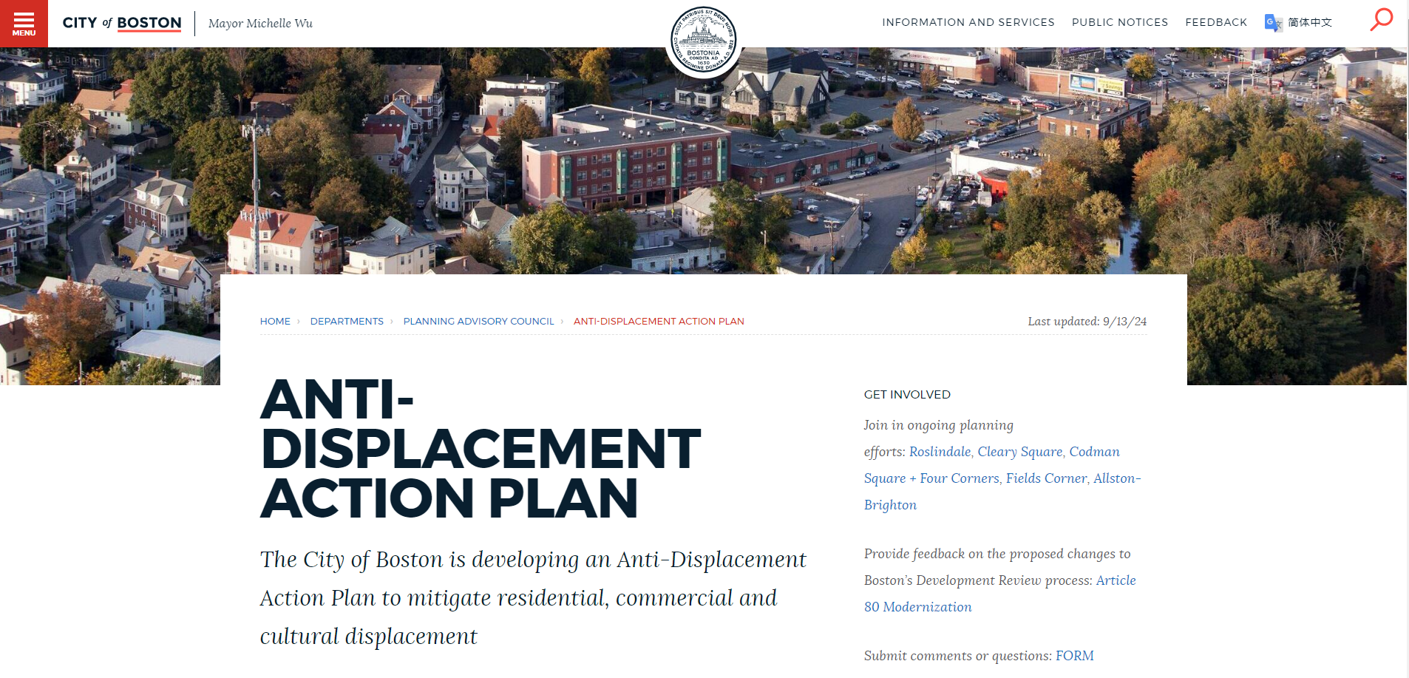
ANTI-DISPLACEMENT ACTION PLAN
Notes:
Plan that defines near-term priority actions and IDs partners, staffing, resources necessary to take them
Why now?
Residents have advocated for greater displacement protections at the local and state level for many years. In response, many new protections and tools have been added to the City’s toolbox, and this Administration recognizes the need for a comprehensive plan.
Zoning changes will create new housing and commercial opportunities and we need to put safeguards in place to provide stability for residents and businesses alongside growth.

Slide 28
ANTI-DISPLACEMENT ACTION PLAN
Timeline and Deliverables
Early Fall, 2024: A Summary of Needs synthesizing community input and priorities shared through previous and ongoing planning initiatives and major projects.
Late Fall, 2024: A new Dynamic Displacement Risk Index analyzing risk and helping to inform planning and development.
Late Fall, 2024: Existing Toolkit & Progress Report summarizing existing tools to mitigate displacement and providing data on how they are working.
Winter, 2025: Boston’s first Anti-Displacement Action Plan with recommendations to address gaps in our toolbox.
1
2
3
4

Slide 29
EXISTING RESIDENTIAL DISPLACEMENT TOOLS
PROTECT
PRESERVE
PRODUCE
PROSPER
Prevent renters and low-income homeowners from being displaced
Make sure affordable public and private housing stays affordable
Create new housing for people of all incomes
Build wealth through homeownership, workforce development, and financial empowerment
Prevent evictions
Protect tenants
Streamline access to income-restricted housing
Prevent foreclosures
Alleviate maintenance costs
Provide targeted tax relief
Renovate and improve public housing
Underwrite acquisition/ conversion of naturally occurring affordable housing
Maintain an inventory of existing subsidized housing and actively intervene to preserve it
Limit short-term rentals
Rezone for mixed-use TOD and density
Create new public housing
Require income-restricted units in new development
Sell public land for affordable housing
Provide subsidies for affordable housing
Co-locate housing with City facilities
Subsidize downtown office-to-residential conversions
Provide financial/technical assistance to homebuyers
Enable rent to own, including for public housing residents
Rezone for and support ADU construction
Update restrictions on affordable homeownership
Provide job training and career development
Provide financial education to support wealth building
Prioritize local hiring
Notes:
Tenant Stabilization Fund, clinics, landlord supports
Condo Conversion Ordinance

Slide 30
QUESTIONS?

Slide 31
THANK YOU
RSPMOC Co-Chairs
Norm Stembridge & Steven Godfrey
STAY CONNECTED: bit.ly/theRSMPOC
Christine Brandao
christine.brandao2@boston.gov

